Slide 1

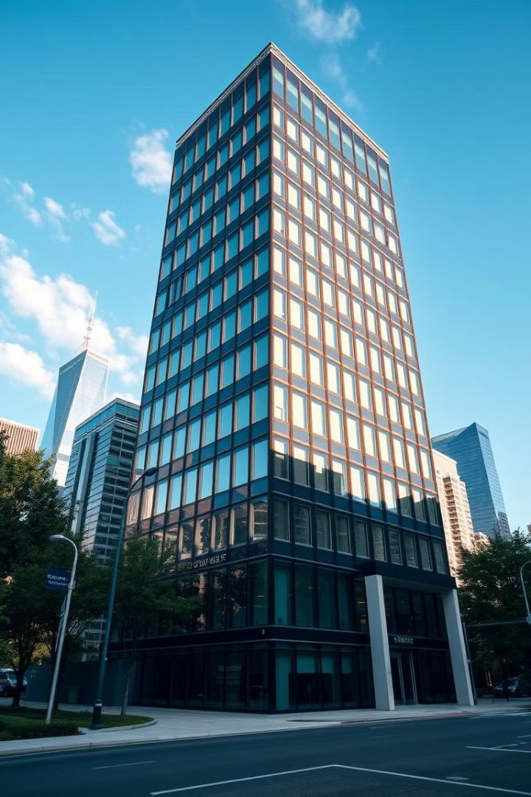





Skyline Properties CRM Project: Streamlining Customer Relations
A presentation by Shreyash, Dhananjay, Nitin, and Krushna.
Notes:
1

Slide 2

Introduction: Skyline Properties & CRM
Skyline Properties is implementing a CRM project. This project aims to streamline customer relations. Customer Relationship Management (CRM) proved beneficial in improving the system – client relationship by easing the functionalities.
1
Purpose of CRM Project
It helps construction businesses manage projects, teams, and client relationships more effectively.
2
Project Goals
To enhance security by detecting unauthorized access and vulnerabilities
Notes:
2

Slide 3
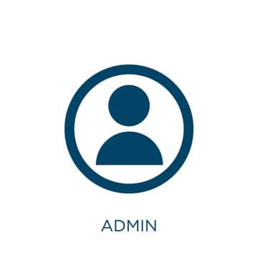

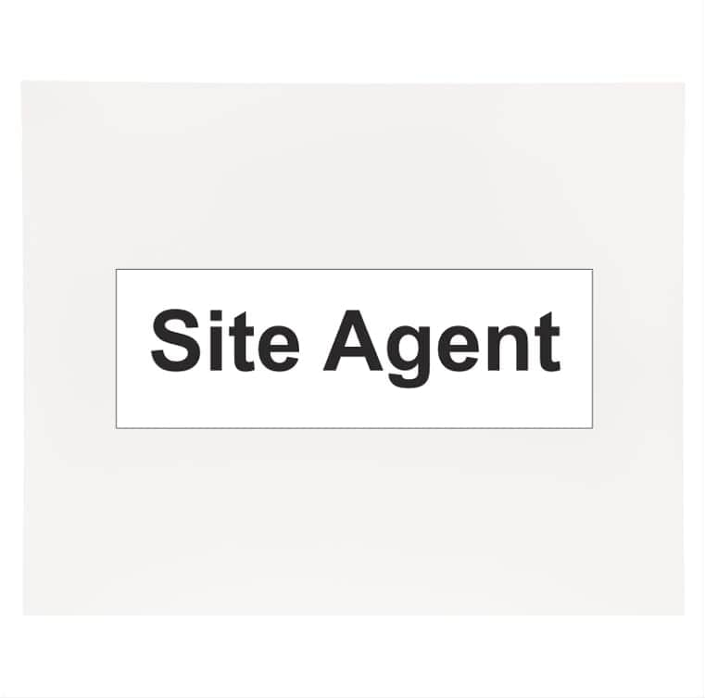
Key Roles in the System ....
Admin: Manages the entire system, monitors projects, and generates reports.
Employee: Handles project updates, documentation, and coordination.
Agent: Manages client relationships, lead generation, and negotiation
Notes:
3

Slide 4




CRM Project Objectives for Skyline Properties
The Skyline Properties CRM system focuses on clear objectives. These objectives will greatly enhance business operations.
Customer Satisfaction
Increased Sales
Better Data Management
Drive revenue growth. Optimize sales processes.
Improve customer relationships. Boost satisfaction levels.
Centralize customer data. Enhance data accuracy.
Notes:
4

Slide 5

Technology: JSP and its Purpose
Java Server Pages (JSP) was chosen for this project. JSP offers several advantages for web development. It allows dynamic content creation. It also integrates well with Java technologies.
What is JSP?
1
JSP is a technology. It helps to create dynamic web pages.
2
Advantages of JSP
JSP is scalable and maintainable. It is good for enterprise applications.
Why JSP?
3
It is versatile and robust. It offers strong community support.
Notes:
5

Slide 6
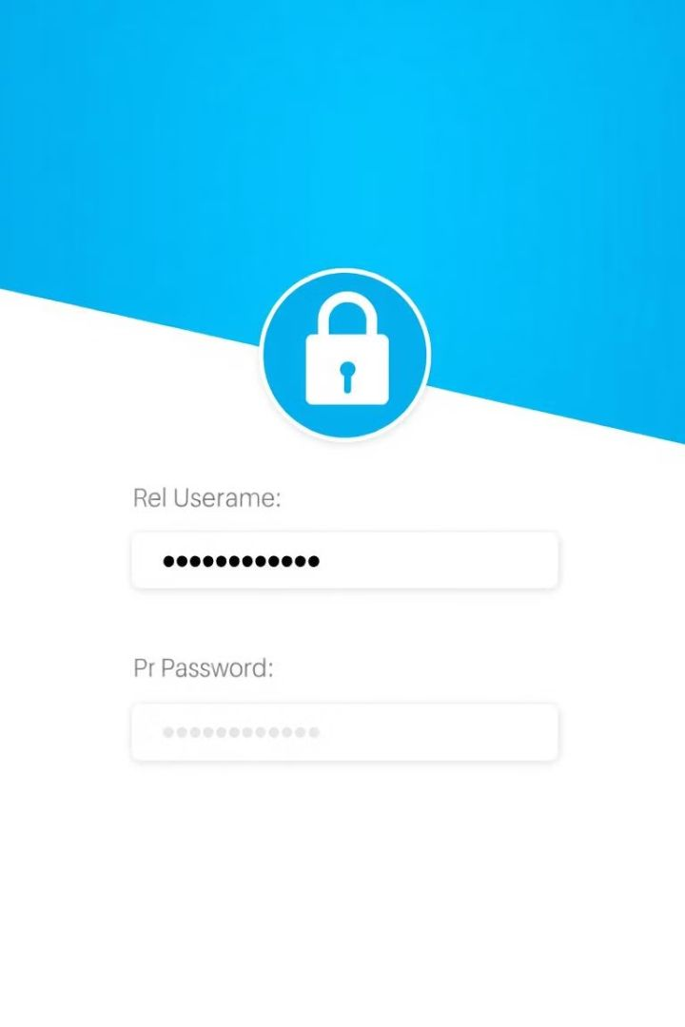



Login Page: The Gateway to User Roles
The login page is the entry point to the CRM system. It accepts User IDs and Passwords. Secure authentication ensures only authorized access.
User ID
Users enter their unique ID.
Password
Users enter a secure password.
Authentication
The system verifies credentials.
Notes:
6

Slide 7
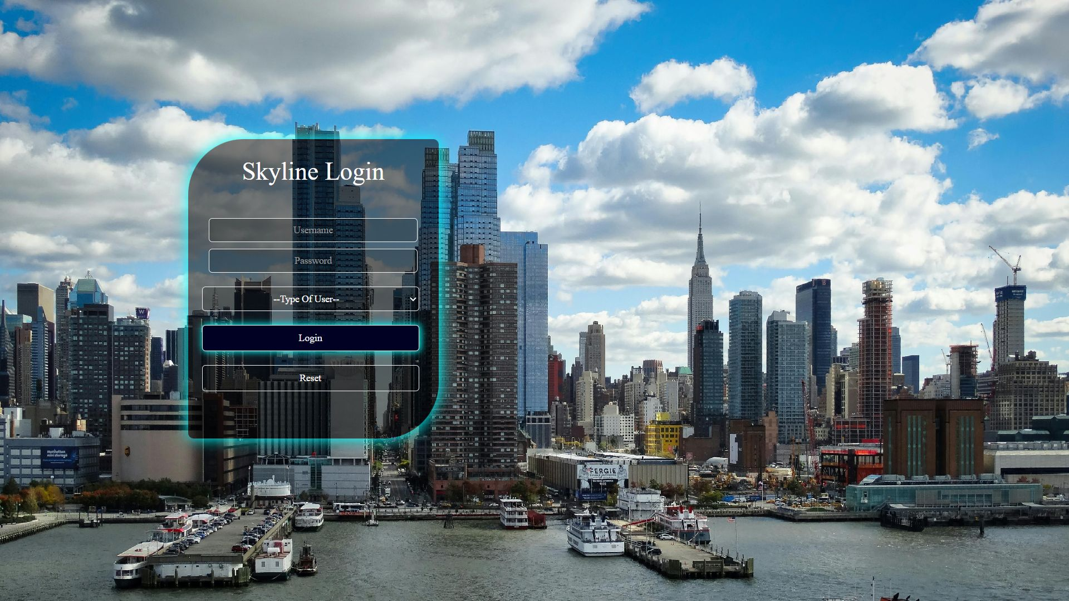

Slide 8
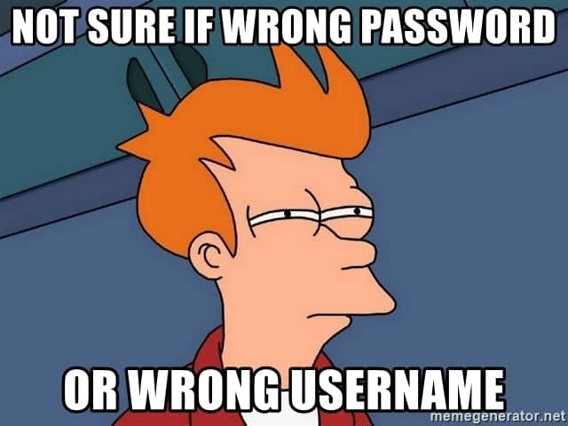
But What If Someone enters some Wrong Credentials?

Slide 9


Slide 10



User Categorization and Dashboard Redirection
The system categorizes users into Admin, Employee, and Agent roles. Each role has a specific dashboard. Redirection ensures access to relevant features.
2
Employee
Limited access.
Admin
1
Full access.
Agent
3
Client focused.
Notes:
7

Slide 11
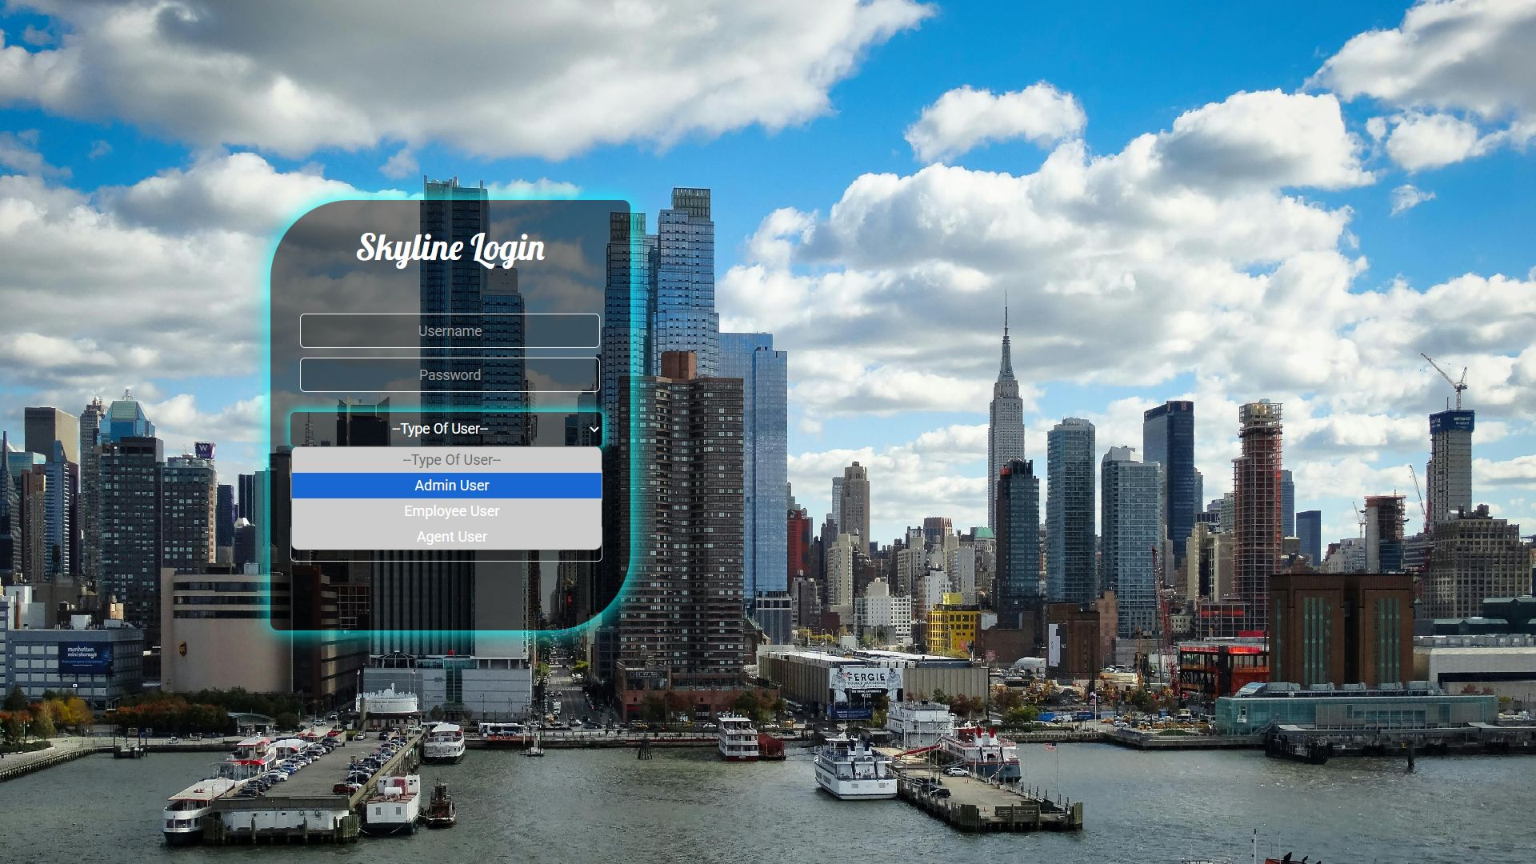

Slide 12
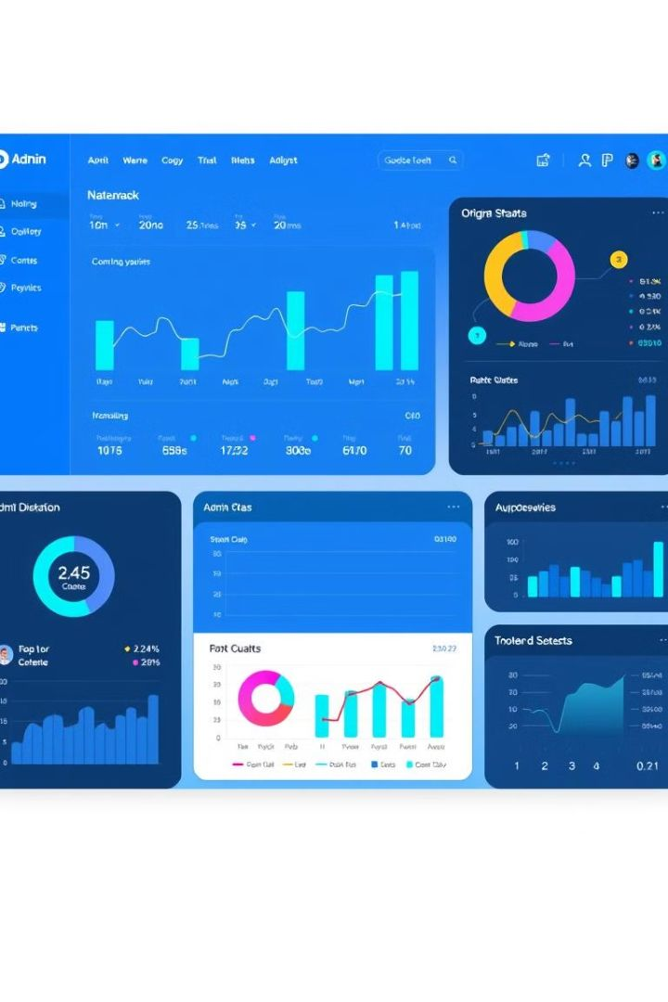
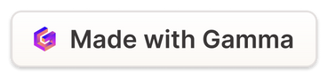
Admin Dashboard Overview
The Admin dashboard provides comprehensive control. It features user management and system configuration. Visuals of the dashboard layout are included.
User Management
Add, edit, and delete users. Control user access.
System Configuration
Set up system parameters. Manage settings.
Notes:
8

Slide 13
Employee and Agent Dashboards
Employee and Agent dashboards cater to specific roles. Functionality is tailored to their responsibilities. Visuals of dashboard layouts highlight key differences.
Employee
1
Task management.
Agent
2
Client relations.
Notes:
9

Slide 14
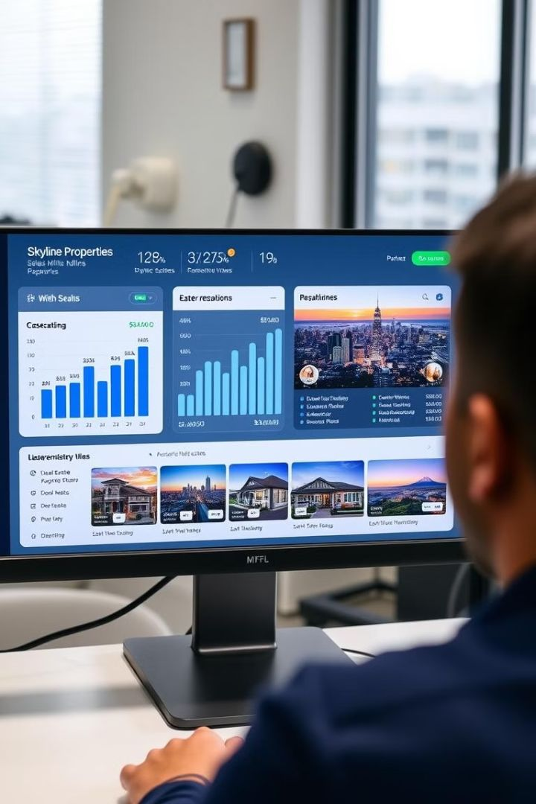
Skyline Properties CRM Project : Agent Dashboard Overview
Welcome to the Skyline Construction Agent Dashboard. This presentation provides an overview of the dashboard's features and functionalities, designed to streamline your workflow and enhance productivity.

Slide 15

Dashboard Overview
The dashboard provides access to key functions. These include enquiry management, bookings, sales entries, and request handling. The dashboard is designed for efficient tracking and management of all agent activities.
Enquiry Management
Booking Management
Sales Tracking
Request Handling

Slide 16
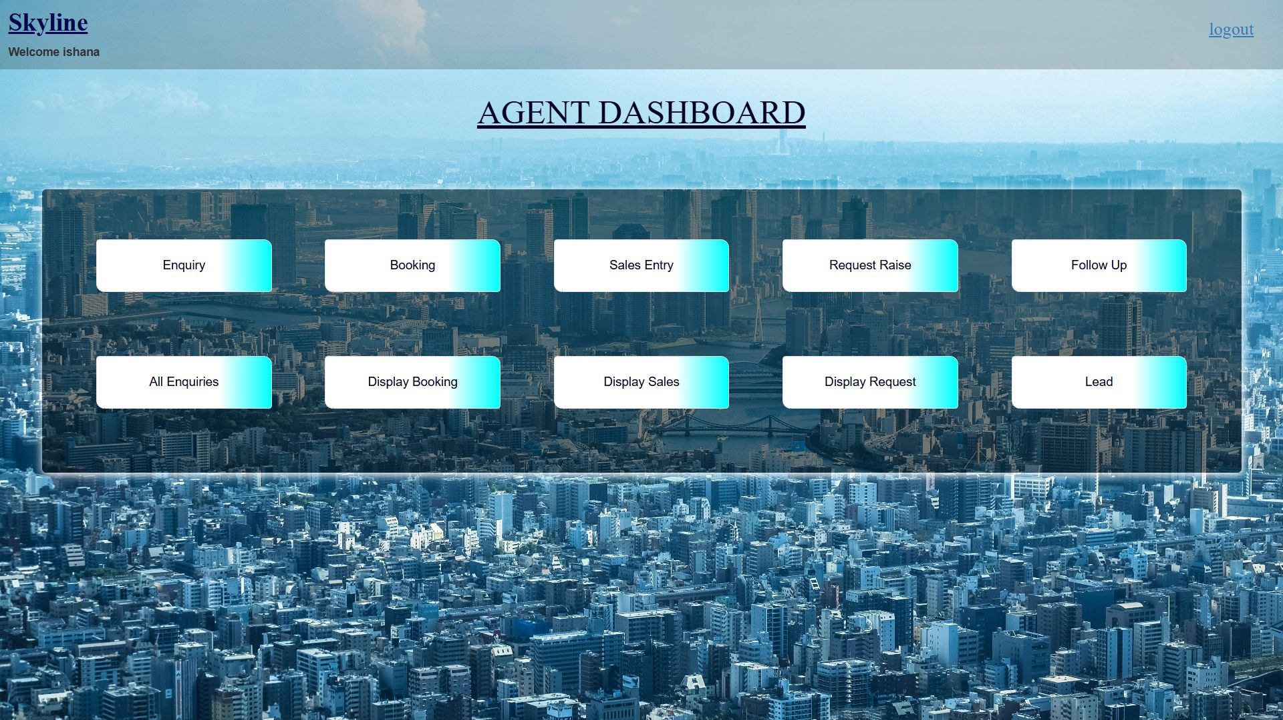

Slide 17

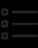
Enquiry Management
Enquiry function initiates a new enquiry process. Agents can collect and record customer queries efficiently. This ensures no potential client is missed.
Start New Enquiry
Record Customer Data
Quickly initiate new customer inquiries.
Collect and store essential customer information.

Slide 18
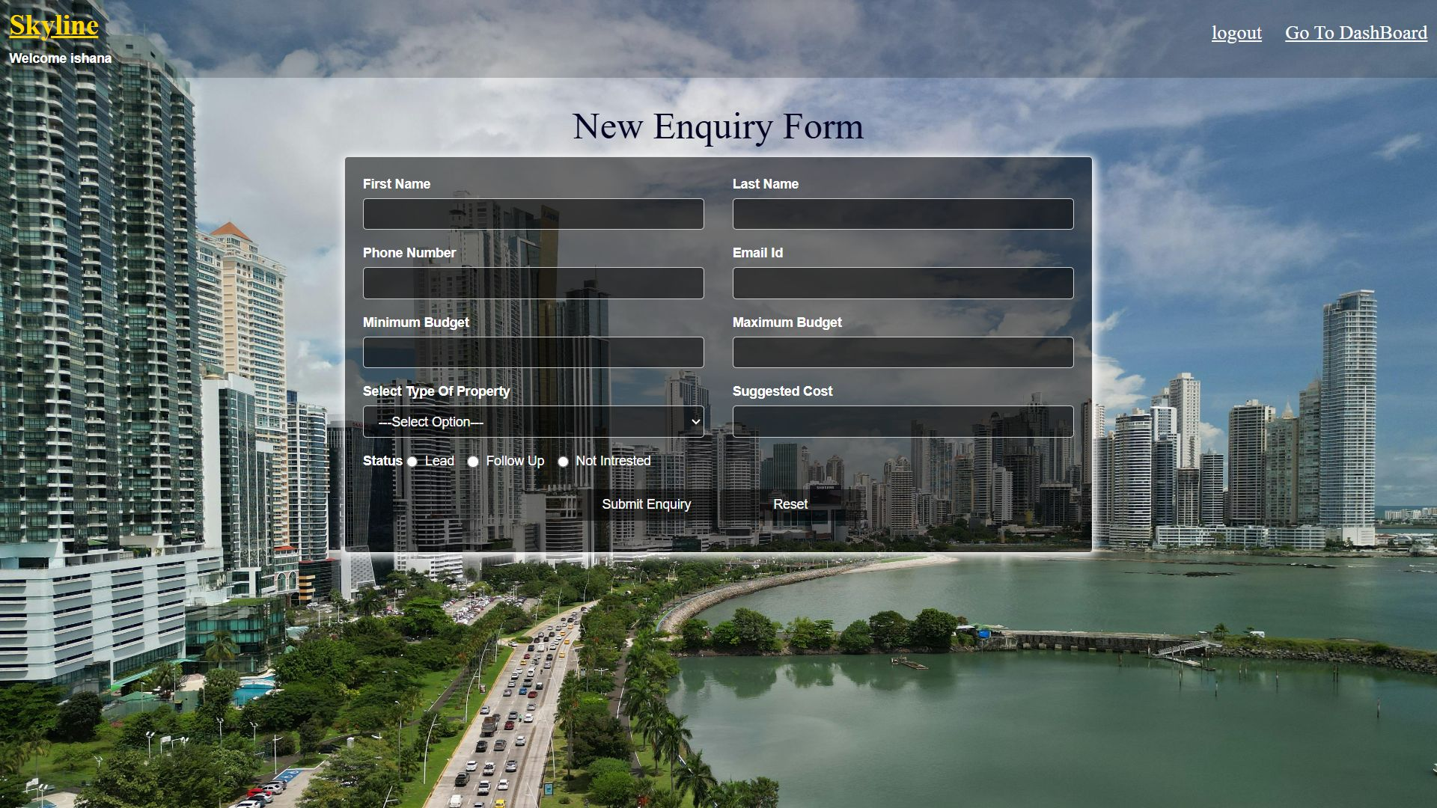

Slide 19
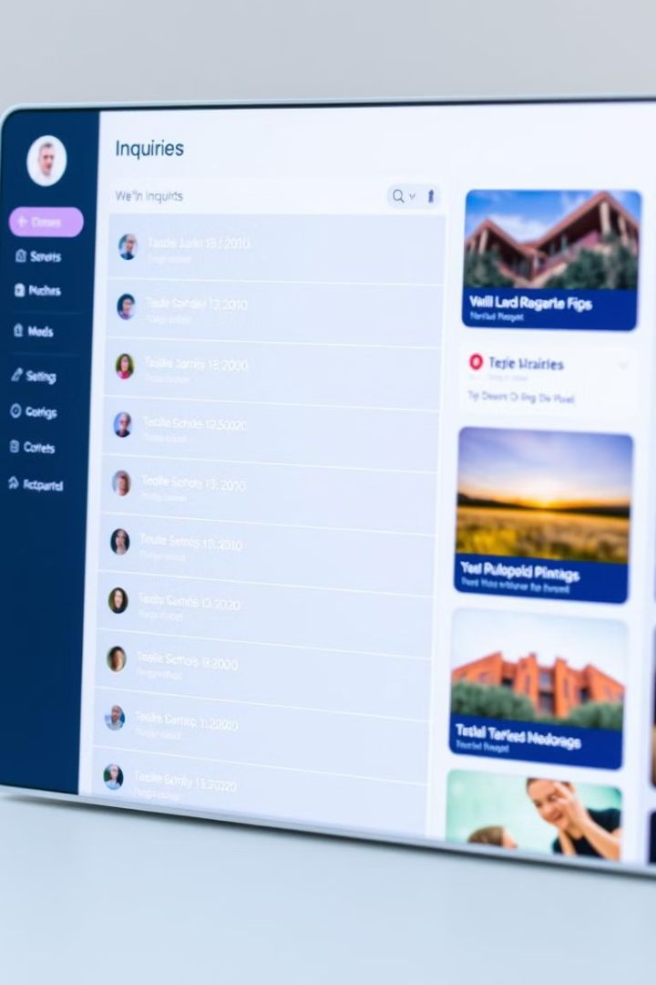



Displaying Enquiries
The Display All Enquiry function lists collected enquiries. Agents can track and manage current and previous inquiries. This allows for comprehensive follow-up and management.
Track Inquiries
Manage Details
Follow-Up

Slide 20
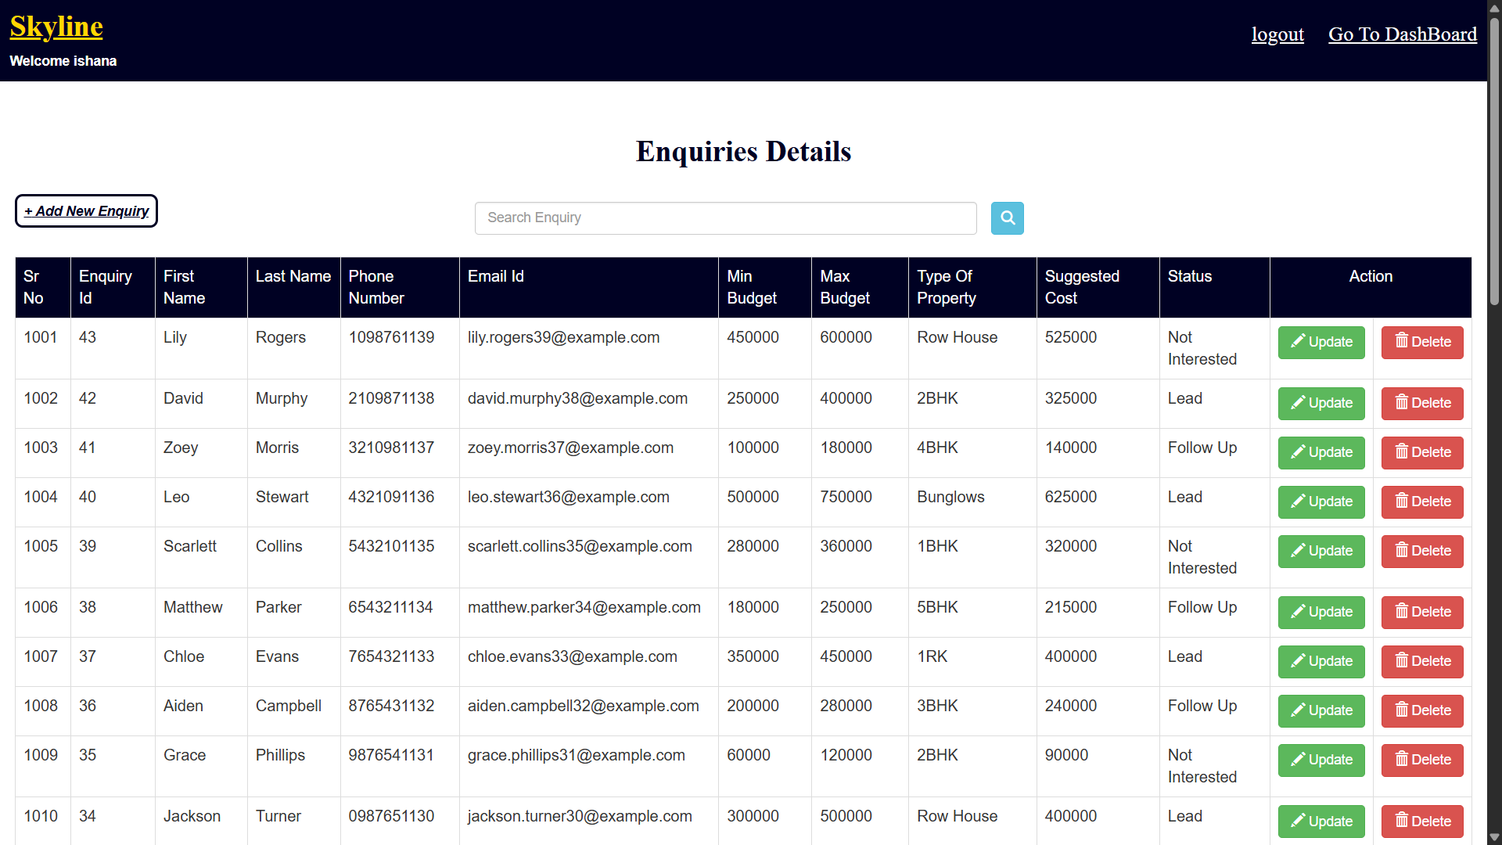

Slide 21



Booking Process
The Booking function facilitates the customer booking process. Agents can finalize and confirm reservations. This makes booking seamless and efficient.
Confirm Availability
Finalize Booking
Send Confirmation

Slide 22
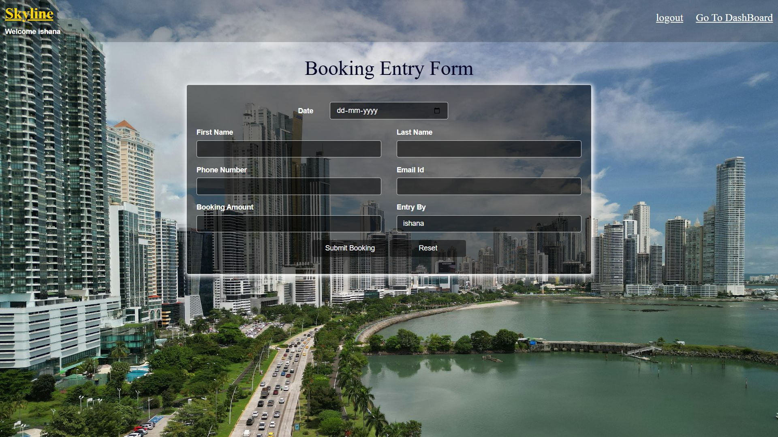

Slide 23
Display Booking
The Display Booking function lists all bookings. Agents can review and manage existing reservations. This provides a clear overview of scheduled activities.
Review Bookings
Manage Reservations
Check dates
Update status
Verify details
Handle changes

Slide 24
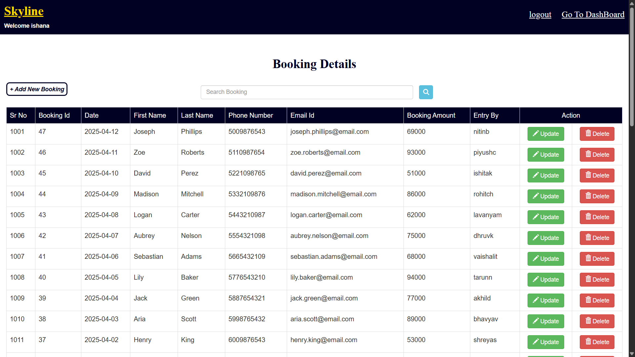

Slide 25



Sales Entry
The Sales Entry function records new sales transactions. This ensures accurate documentation of sales activities. Accurate records lead to better insights.
1
Record Sales
2
Track Revenue
3
Document Transactions

Slide 26
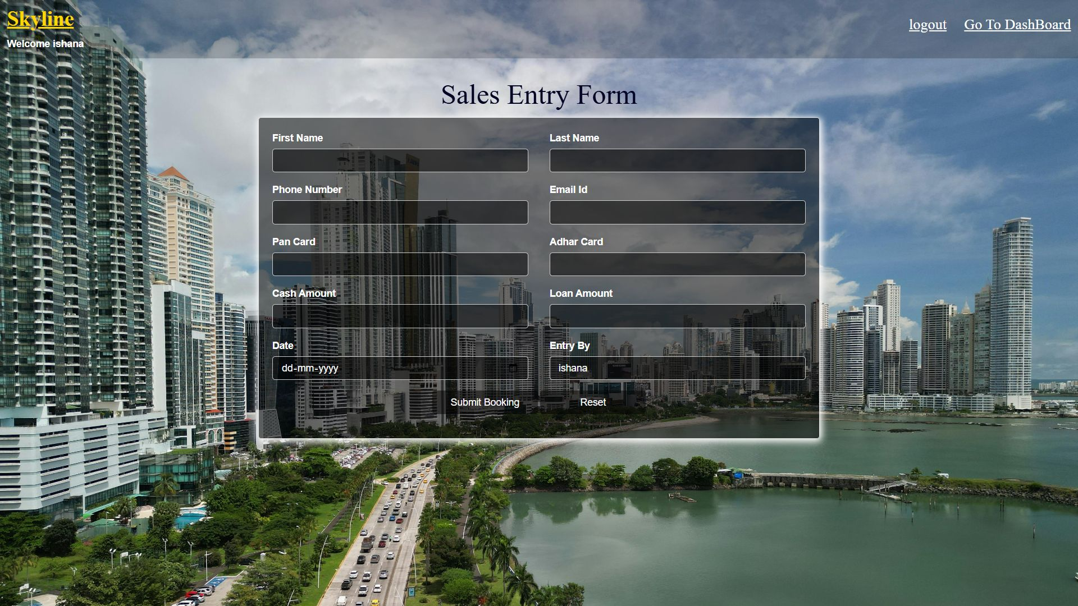

Slide 27
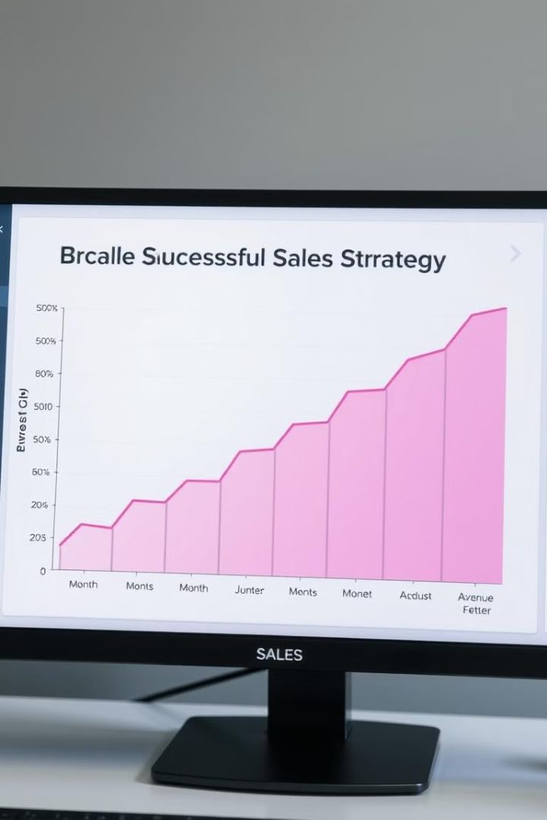
Display Sales
The Display Sales function shows sales reports and listings. Agents gain insights into their sales performance. Analyzing data enables informed decision-making.
15%
Increase
Quarterly Growth
$500K
Revenue
Total Sales

Slide 28
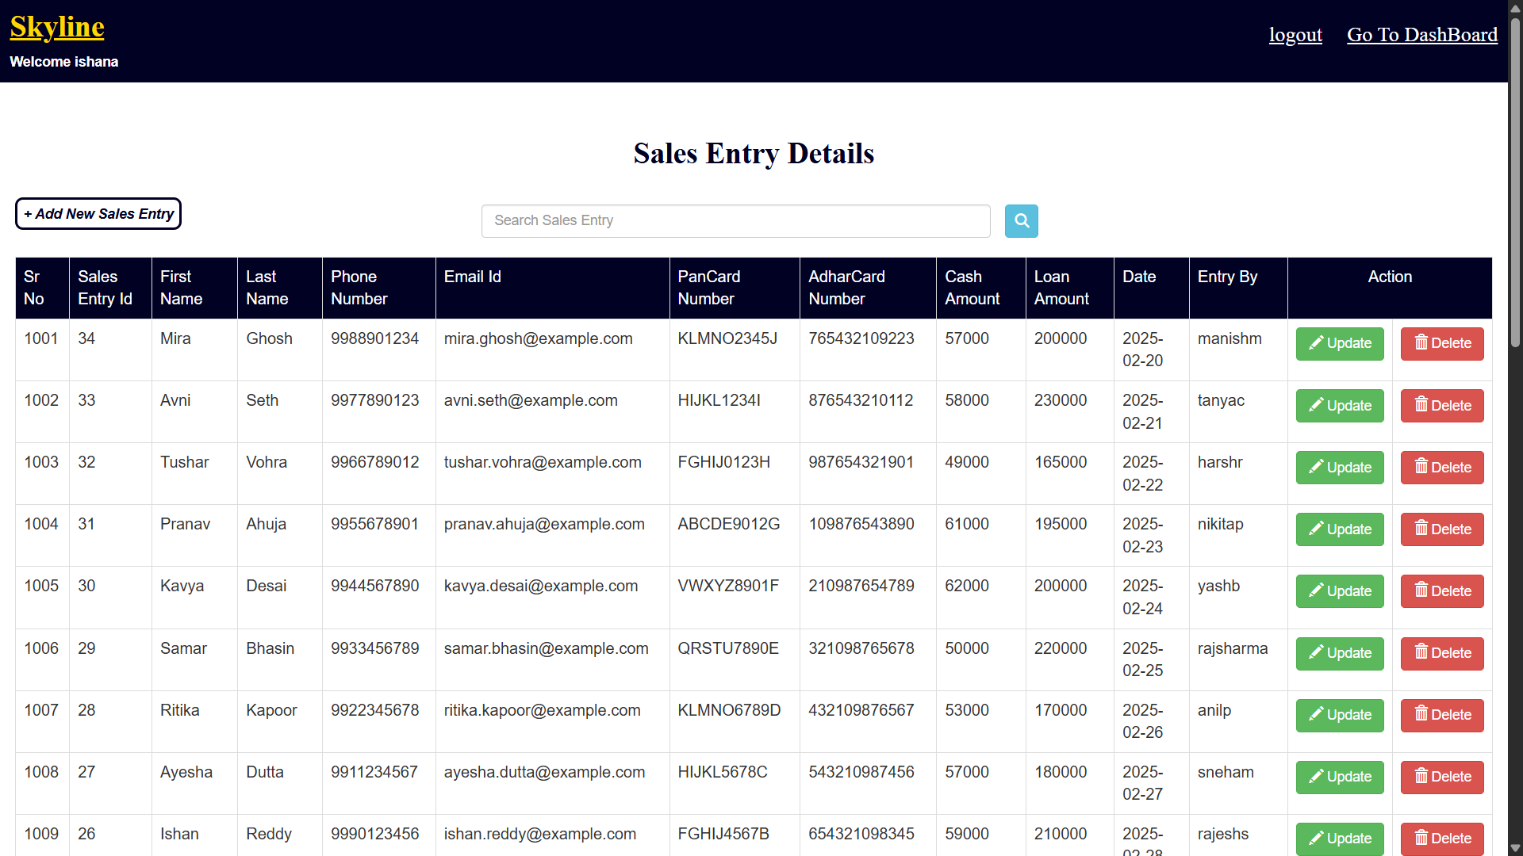

Slide 29
Request Management
The Request Raise allows agents to raise requests. These can be for support, approvals, or additional resources. The Display Request function lets agents view raised requests. This helps track pending or resolved issues.
1
Raise Request
2
View Request
3
Track Status

Slide 30
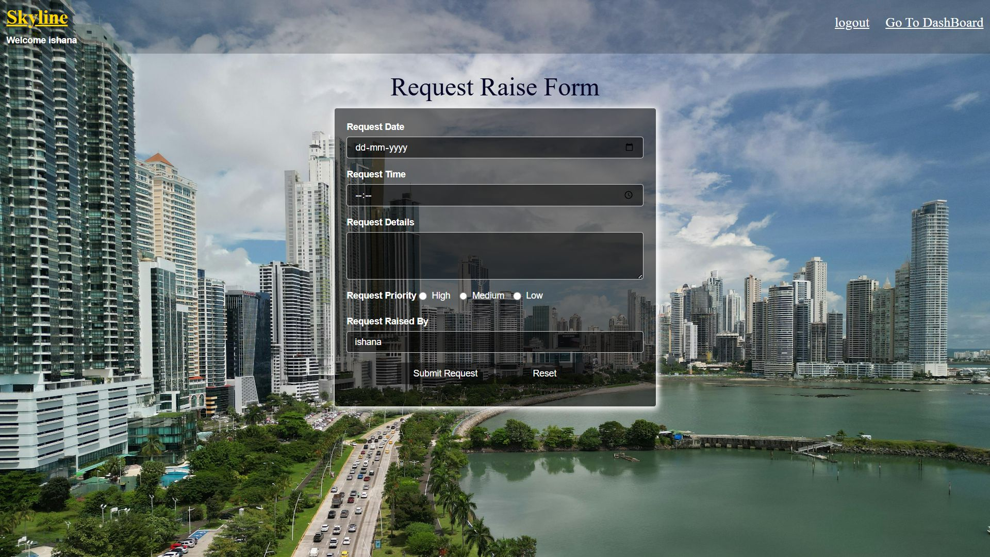

Slide 31
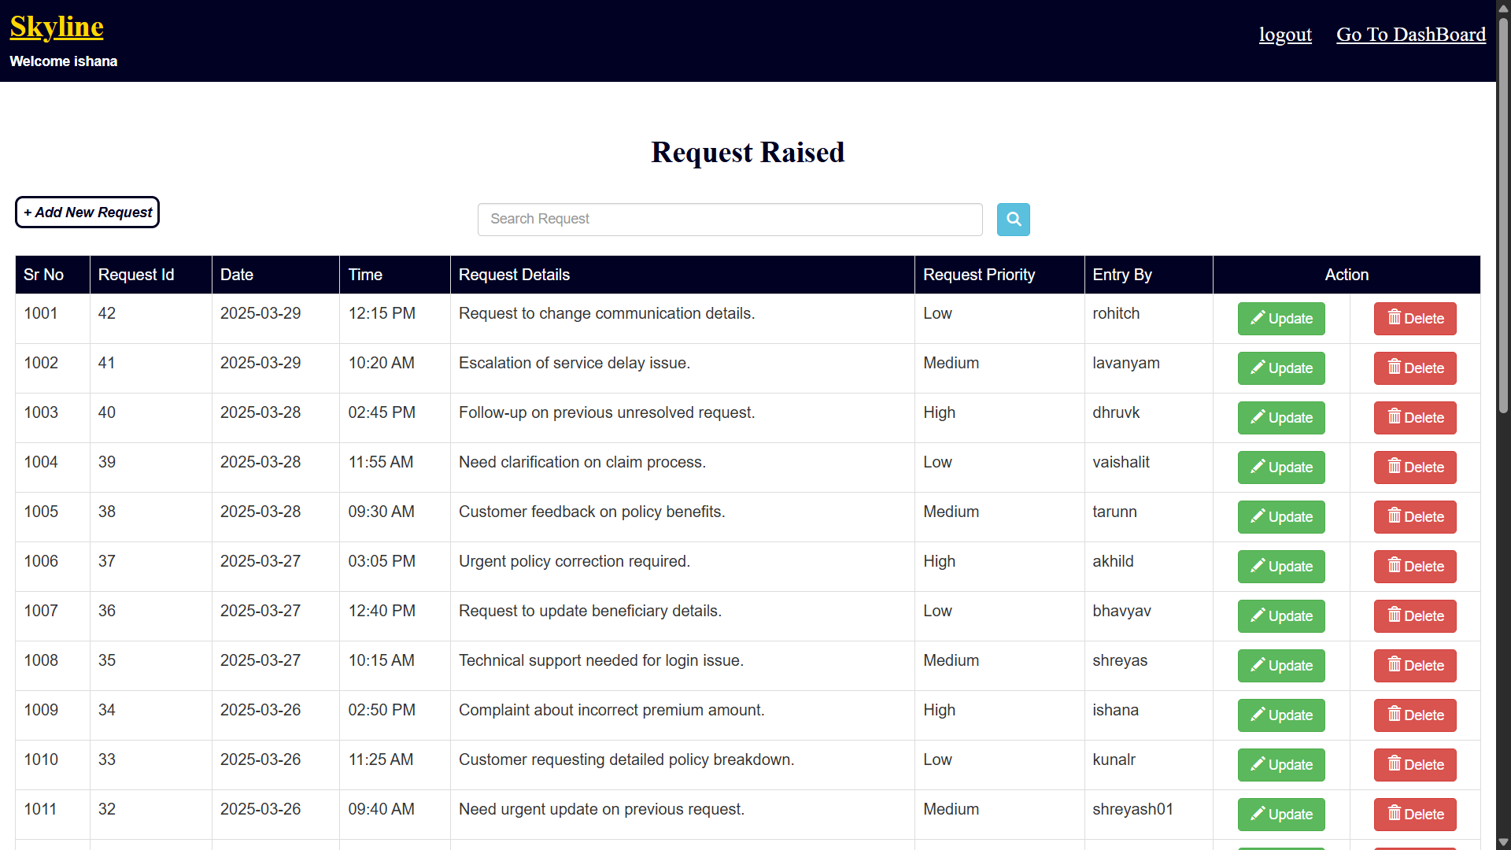

Slide 32
Follow-Up & Lead
The Follow Up feature manages follow-up activities. This ensures timely responses to customers. The Lead function manages potential sales leads. Convert inquiries into actual sales efficiently.
2
Follow Up
1
Identify Leads
Convert Sales
3

Slide 33
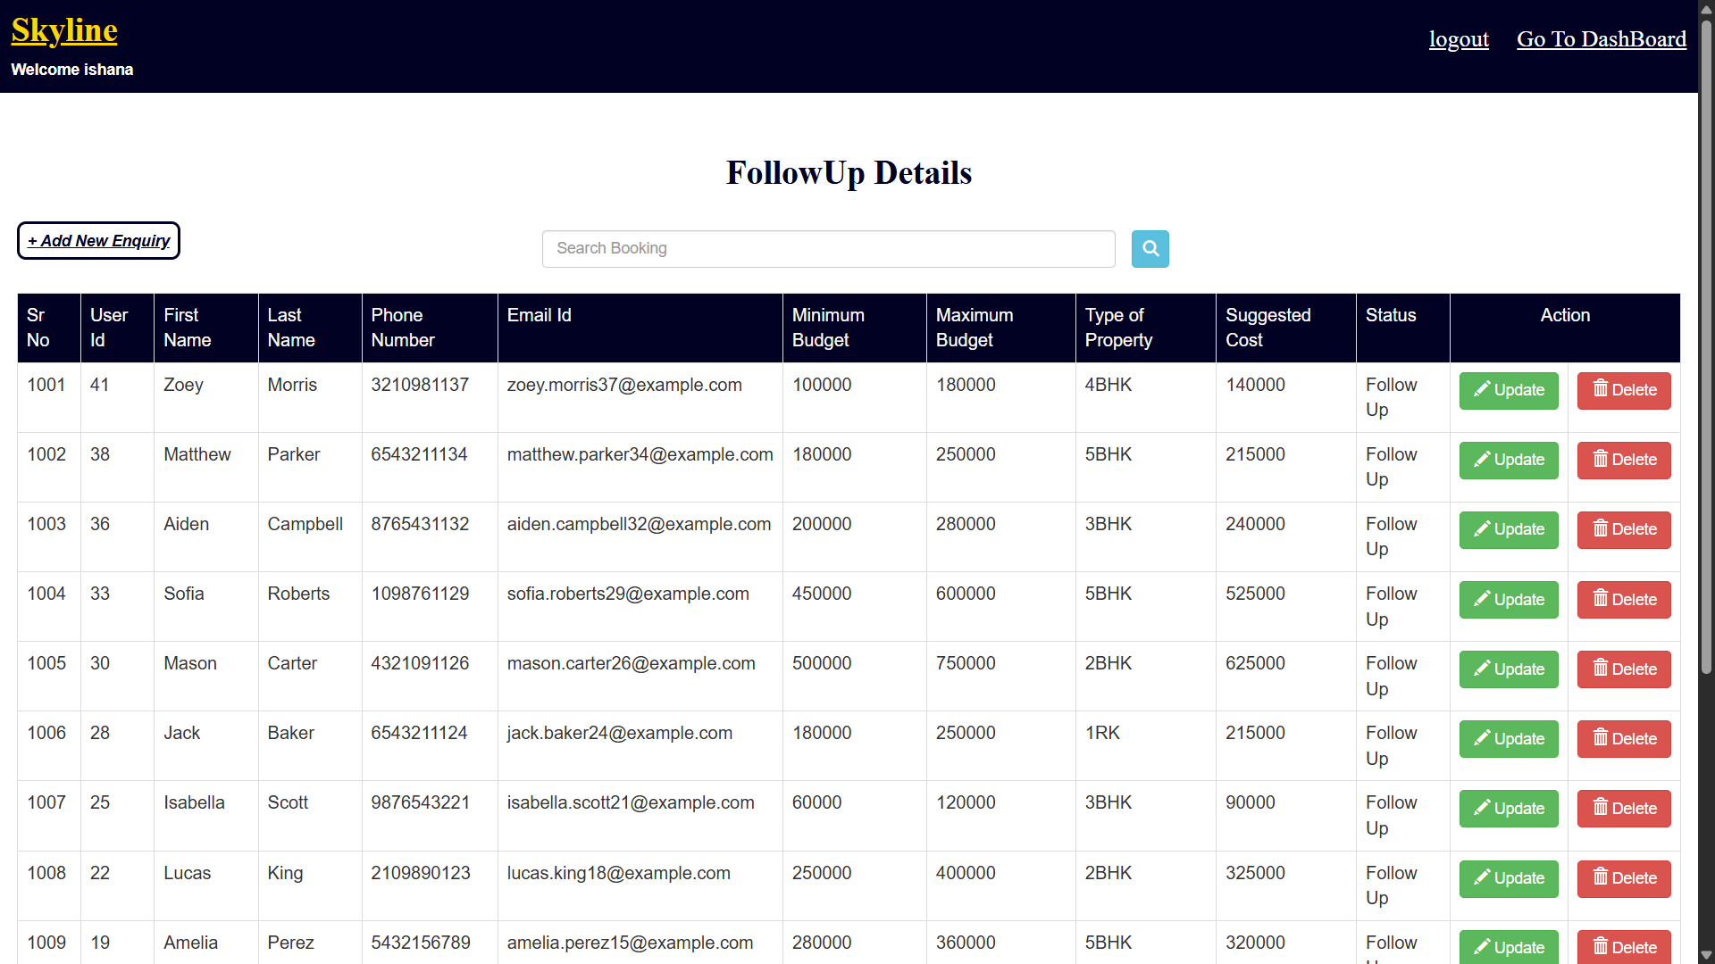

Slide 34
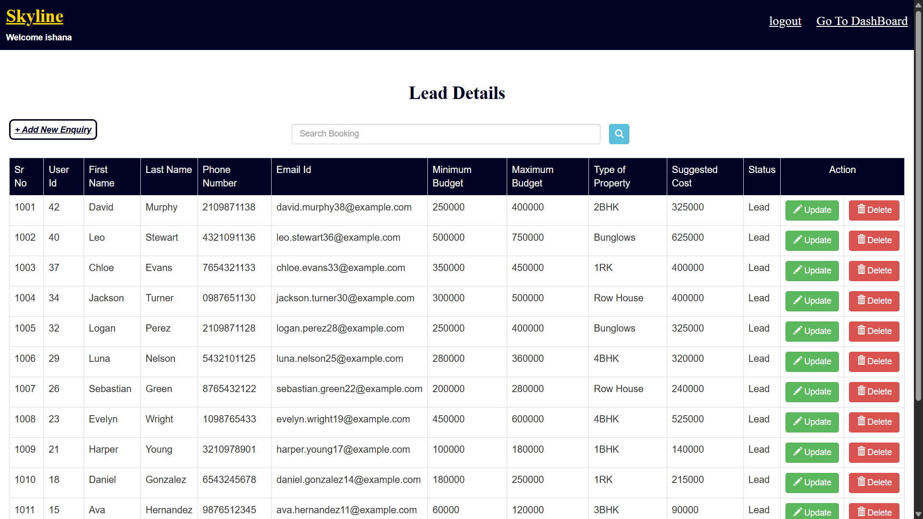

Slide 35

Skyline Properties CRM Project: Employee Dashboard Overview
Streamlining Customer Relationship Management.

Slide 36
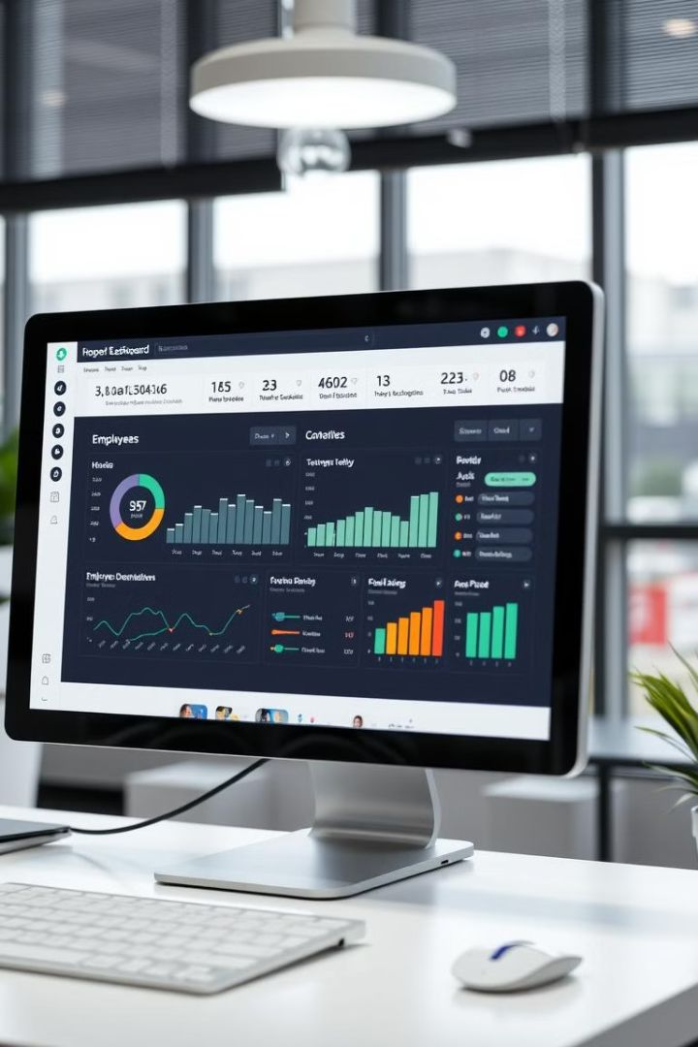



The Central Hub for Managing Customer Interactions
Enquiry
Follow Up
Lead
Handle customer questions.
Track interactions to ensure customer satisfaction.
Turn interest into sales.
The employee dashboard provides an overview of key CRM functions.

Slide 37
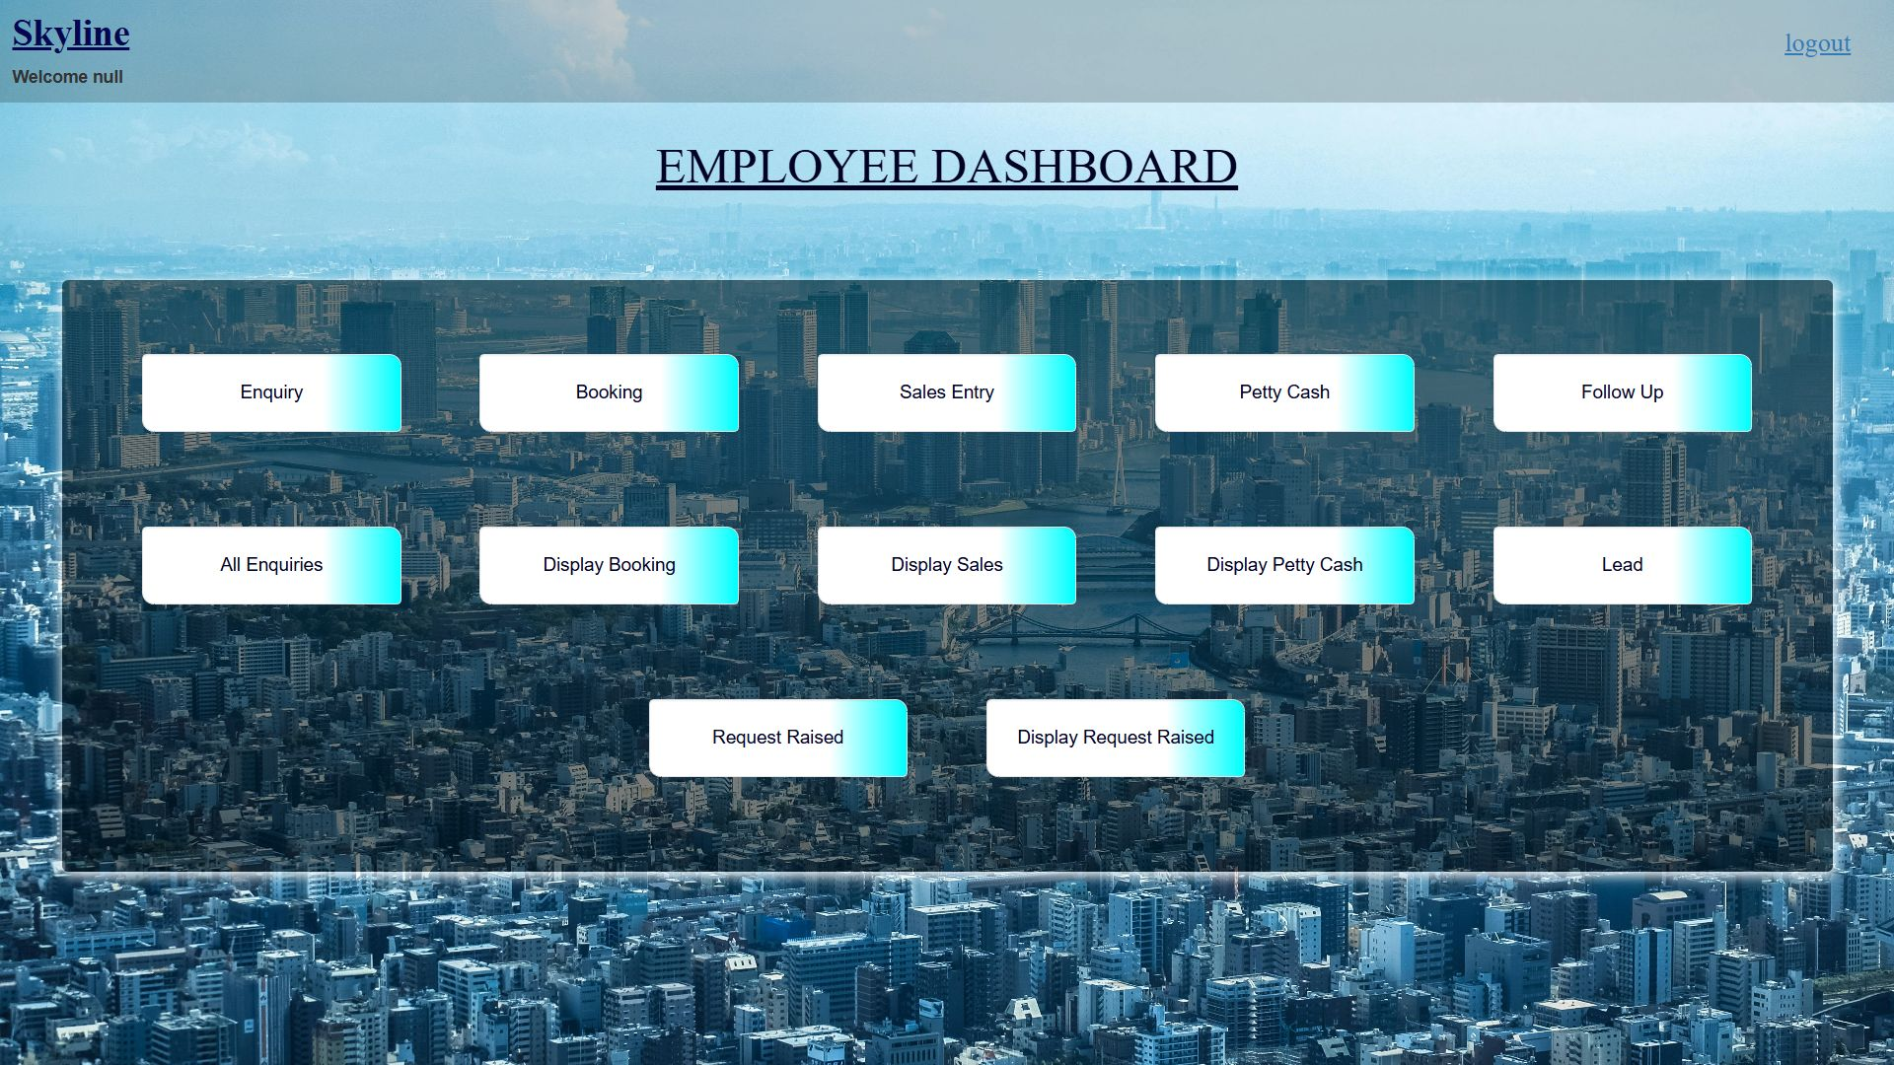

Slide 38


Slide 39
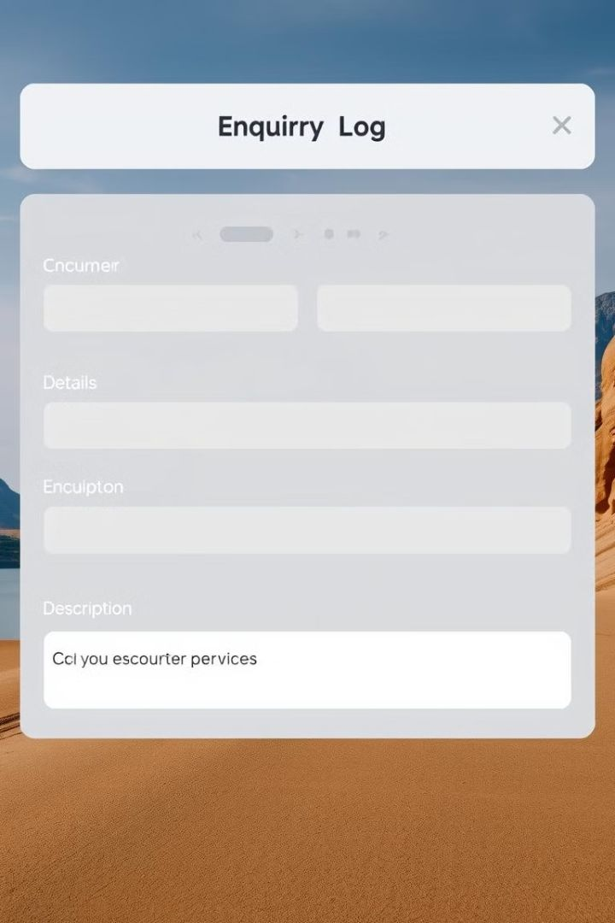
Managing Customer Enquiries Efficiently
1
Log Enquiry
Record customer questions.
2
Track Progress
Monitor until resolution.
3
Respond Quickly
Keep customers informed.

Slide 40
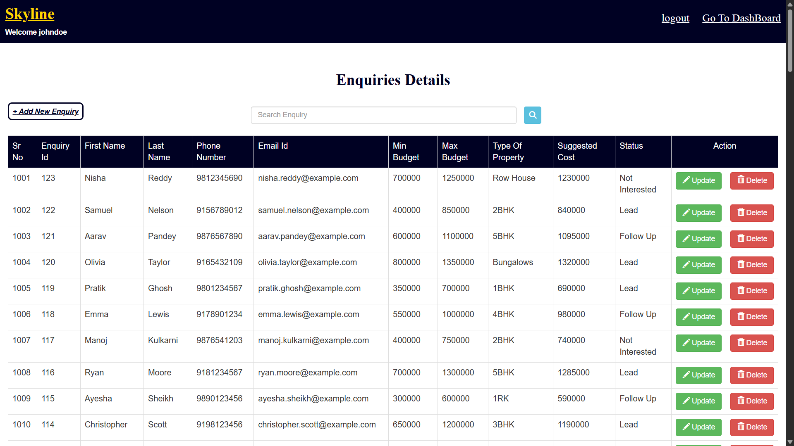

Slide 41
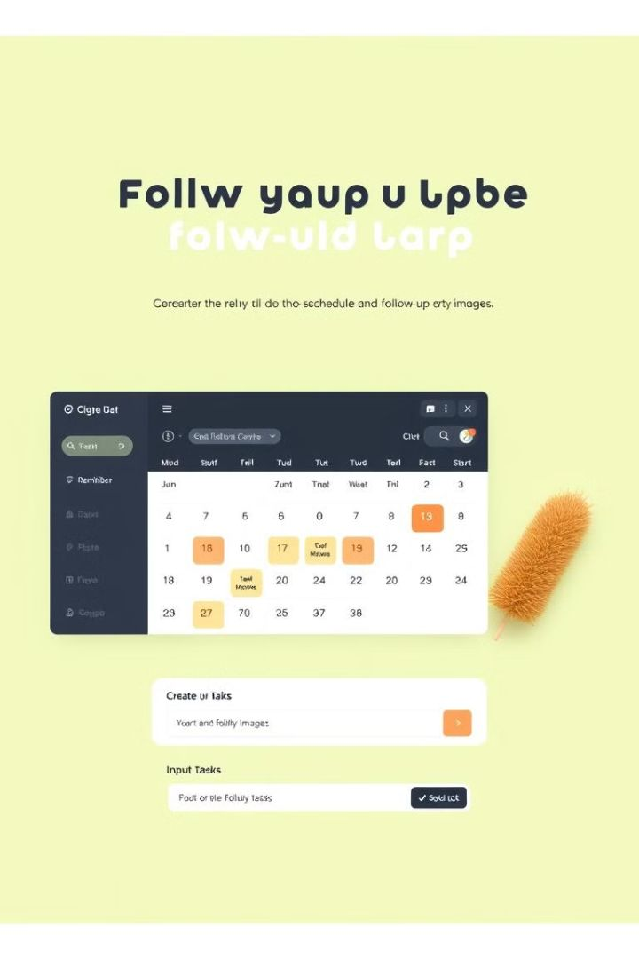
Ensuring Timely Follow-Up on Customer Interactions
Schedule Tasks
Manage Priorities
Set reminders for future contact.
Focus on important items.
Record Notes
Keep track of each interaction.

Slide 42
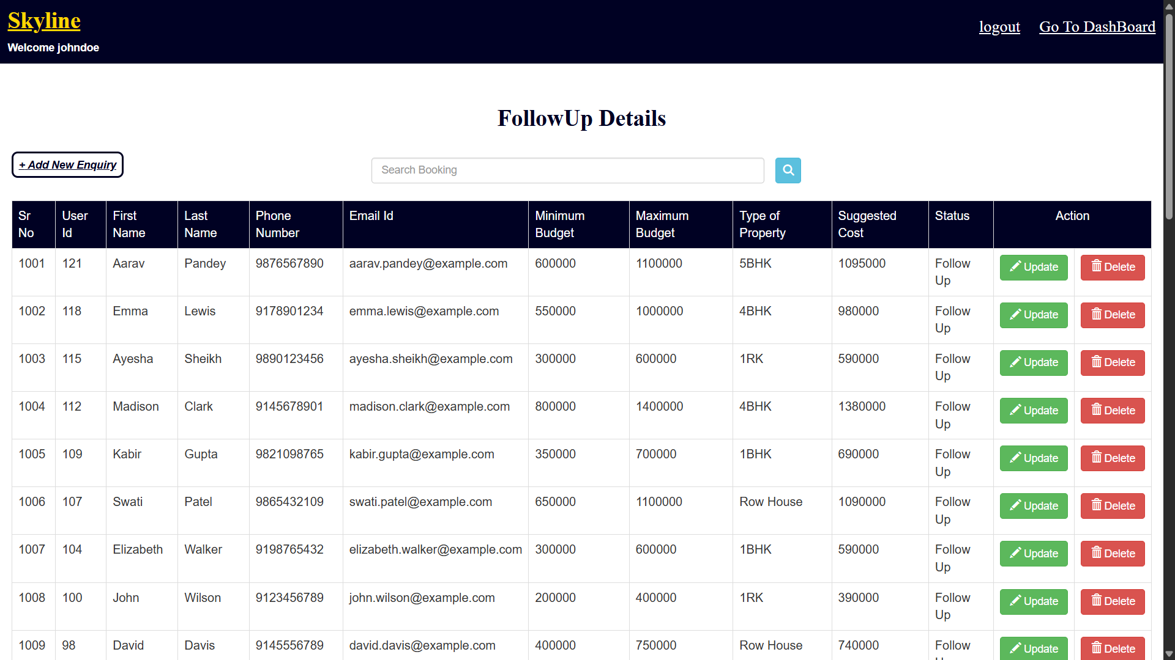

Slide 43
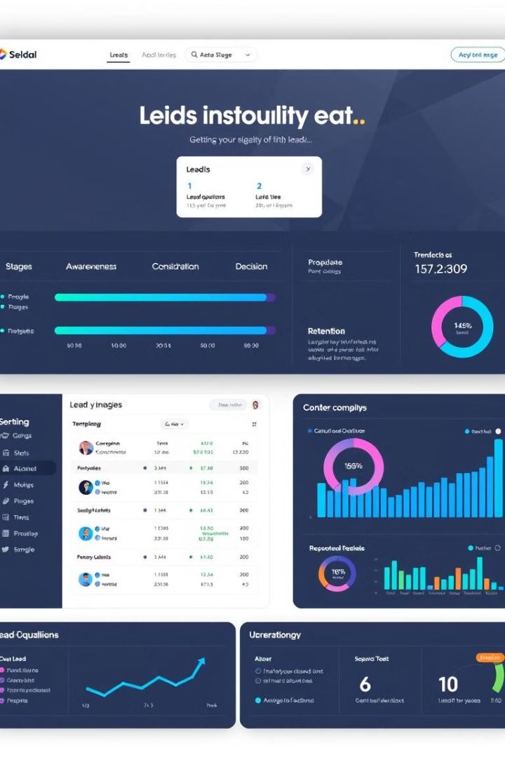
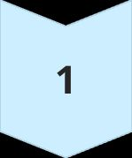


Capturing and Nurturing Potential Leads
Capture Details
Collect contact information.
Qualify Leads
Determine interest level.
Nurture Relationships
Provide useful information.

Slide 44


Slide 45
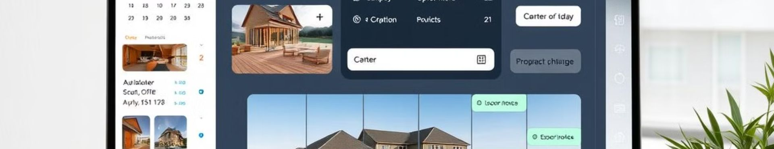
Streamlining the Booking Process
1
Easy Scheduling
2
Calendar Integration
3
Automated Reminders
Book properties quickly.
Sync with personal schedules.
Reduce no-shows.

Slide 46


Slide 47
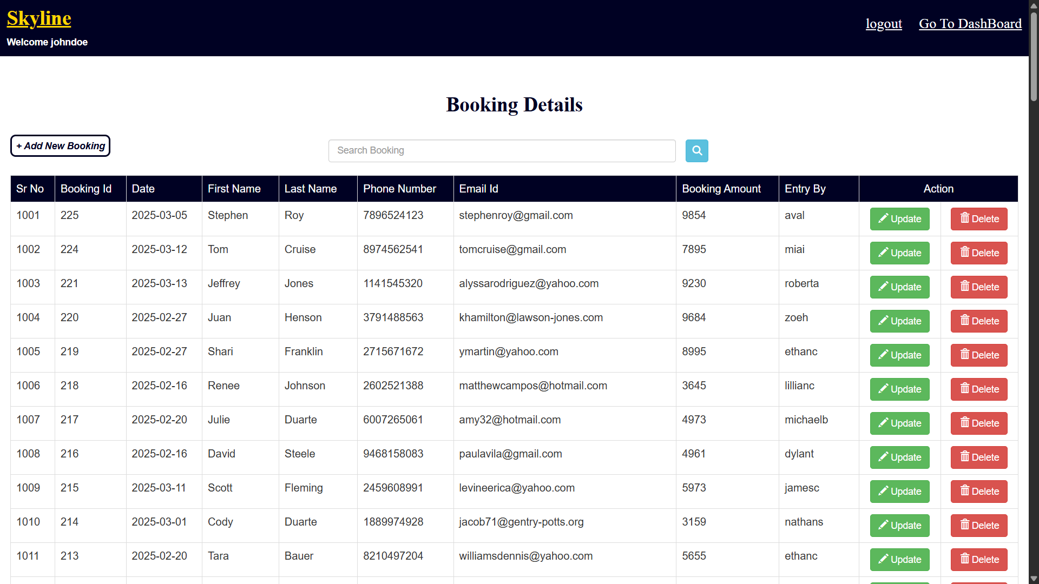

Slide 48
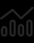


Managing Sales
Track Balances
Record Payments
Generate Reports

Slide 49


Slide 50
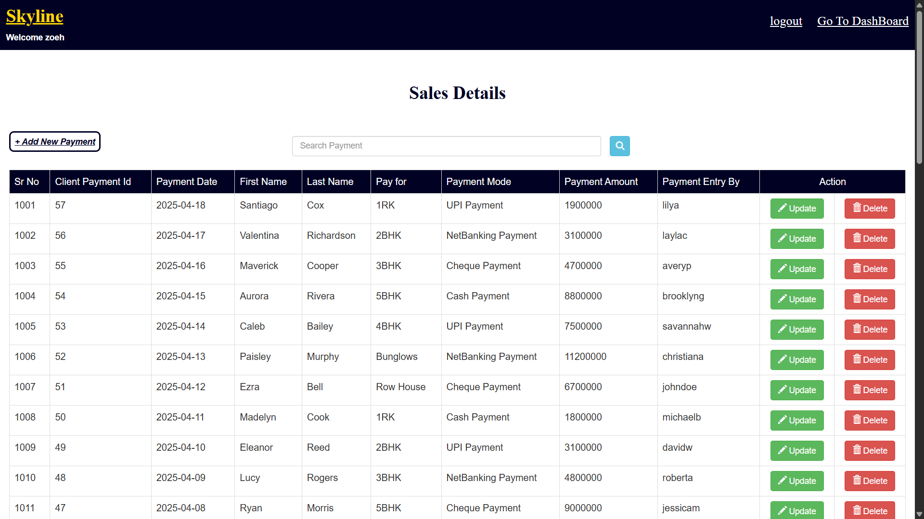

Slide 51
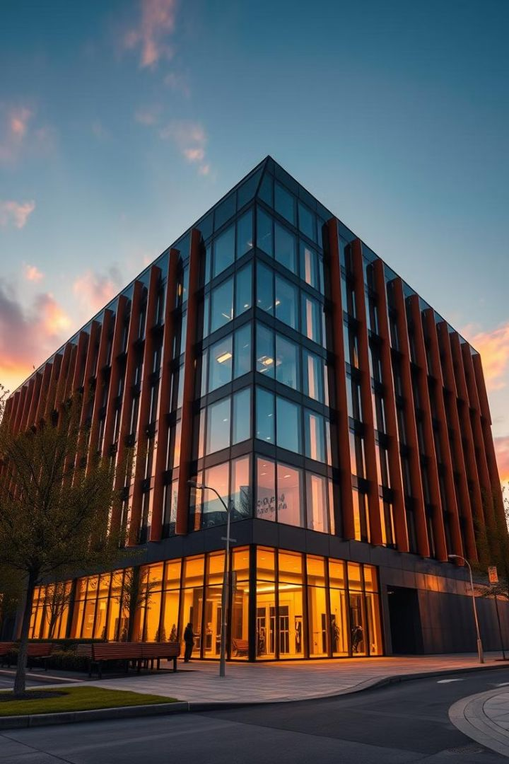
Skyline Project CRM: Petty Cash & Request Raise
This presentation introduces the Petty Cash and Request Raise functionalities within the Skyline Project CRM. Learn how to capture, qualify, and manage these important processes efficiently. We ensure all users have clear visibility and control. Discover how these tools streamline operations and improve employee satisfaction.

Slide 52
Petty Cash Management
Capture Expenses
Qualify & Manage
Employees can easily record petty cash expenses. A user-friendly interface ensures accuracy.
The system helps qualify expenses against policy. Managers can review and approve requests.
Our petty cash functionality ensures a structured approach. It promotes transparency and accountability across the organization.

Slide 53
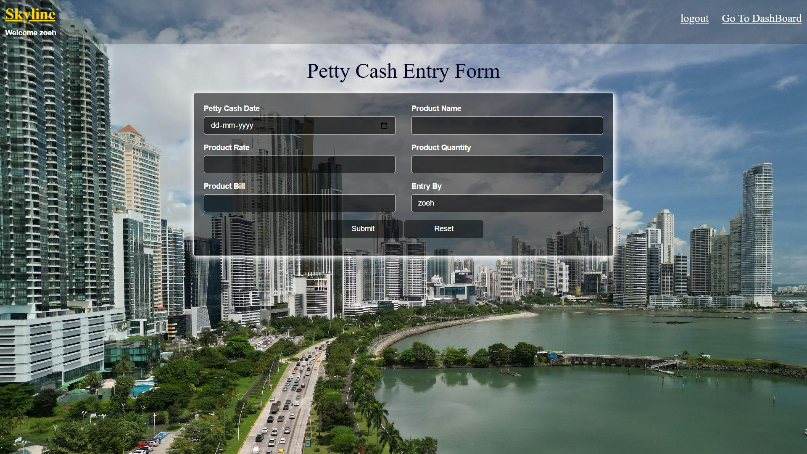

Slide 54
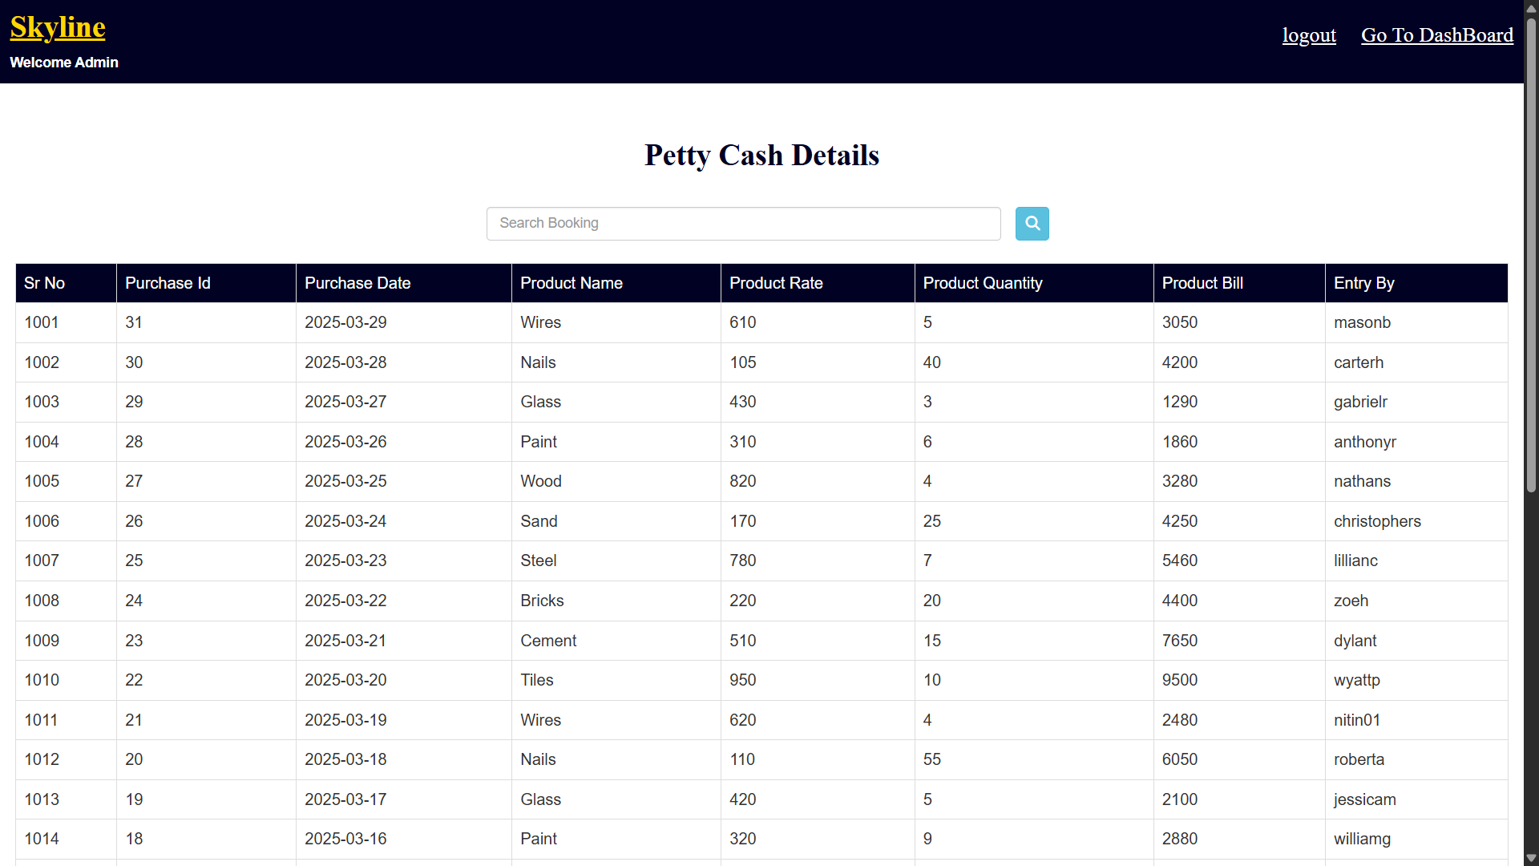

Slide 55
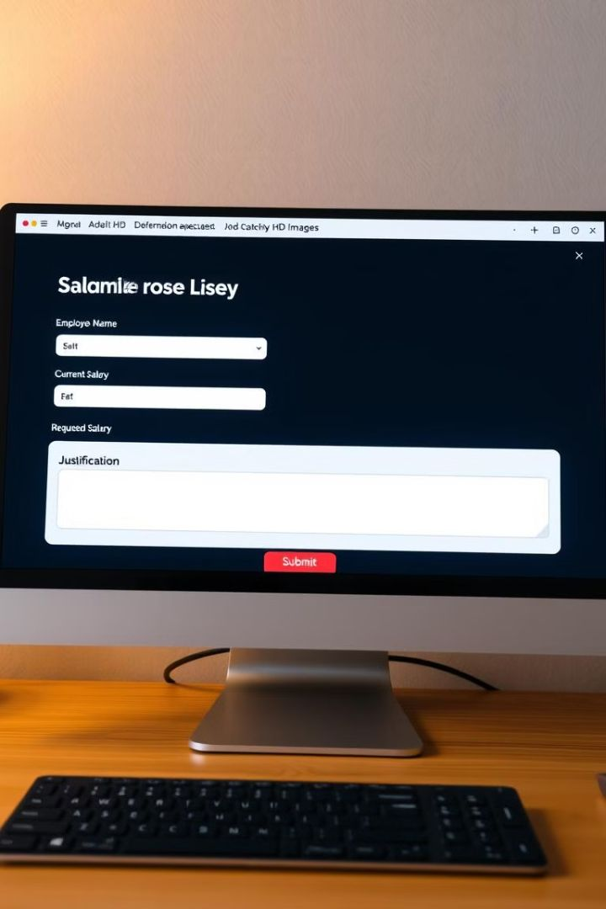
Request Raise Workflow
1
Submit Request
2
Review & Qualify
Employees can submit raise requests. Detailed justification is required.
Managers assess requests based on performance. They also consider budget availability.
3
Nurture Approval
The system tracks request status. Transparency is maintained during the process.
Our request raise function streamlines the process. It ensures fairness and consistency in salary adjustments.

Slide 56


Slide 57
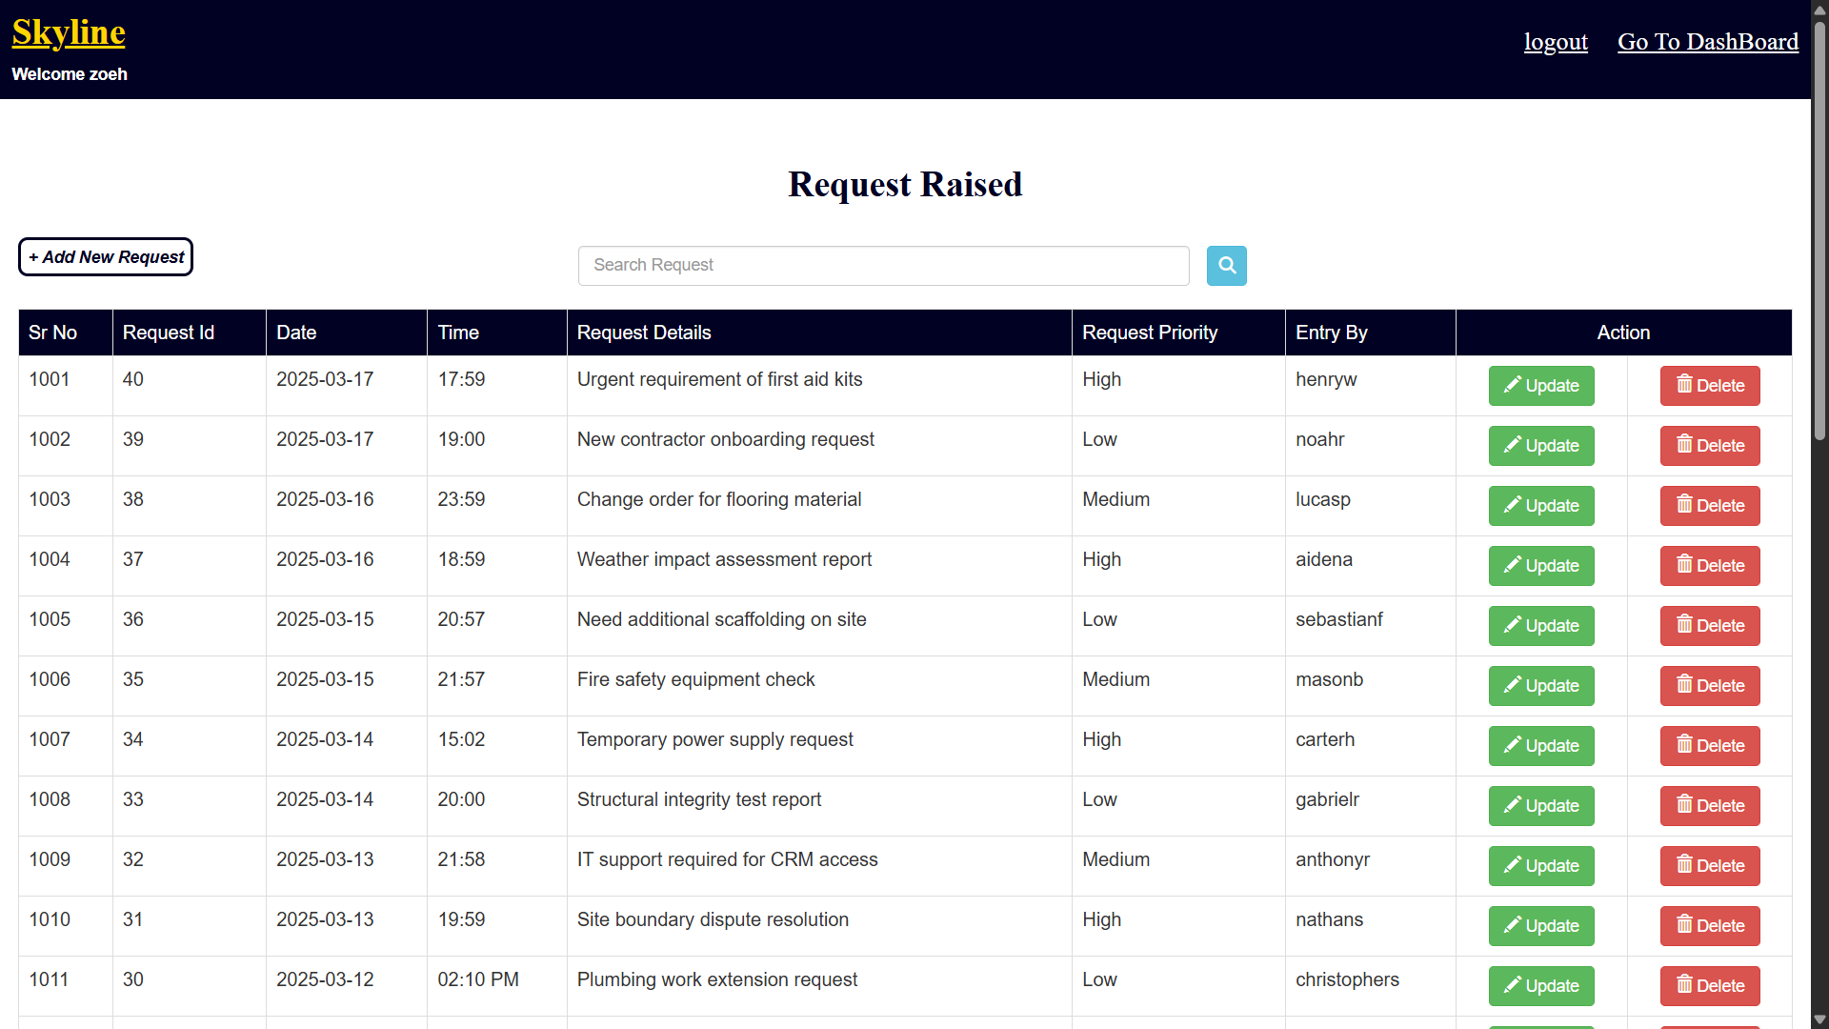

Slide 58




Key Takeaways & Next Steps
Petty Cash
Simplified expense capture and management.
Request Raise
Streamlined approval workflow.
User Visibility
Transparent system ensures accountability.
Explore these functionalities to enhance efficiency and fairness. Contact our support team for training and implementation assistance. Let's optimize your Skyline Project CRM experience today.

Slide 59

Maximizing Efficiency and Customer Satisfaction
The new CRM system will boost customer relations.
It will also streamline processes.
Utilize the new system to maximize the benefits.

Slide 60
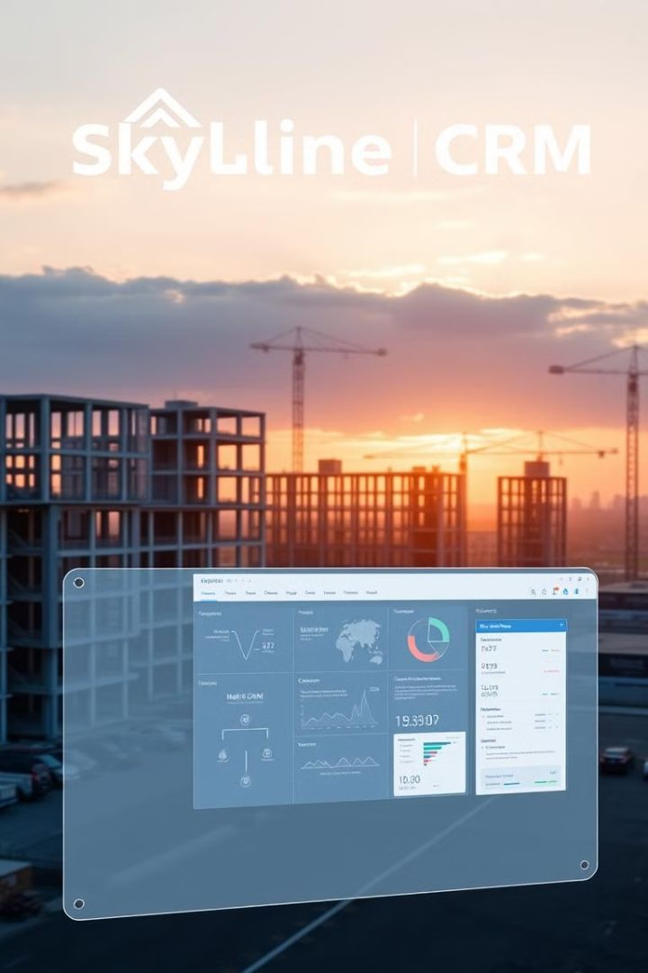
Skyline CRM: Built for Construction Success
Streamline your operations, win more bids, and boost profitability with Skyline CRM.

Slide 61

CRM Admin Dashboard for Construction
Welcome to the CRM Admin Dashboard presentation. This tool is designed to streamline user management, task tracking, and overall efficiency for construction companies. It acts as a central hub, providing comprehensive oversight and control. The dashboard ensures seamless operations and facilitates effective communication across all teams.
This presentation offers a detailed overview of each section within the Admin Dashboard, highlighting its functionalities and benefits for construction project management. We will explore user management, task assignment, and agent monitoring, showcasing how this system can improve productivity and reduce administrative overhead.
NJ

Slide 62
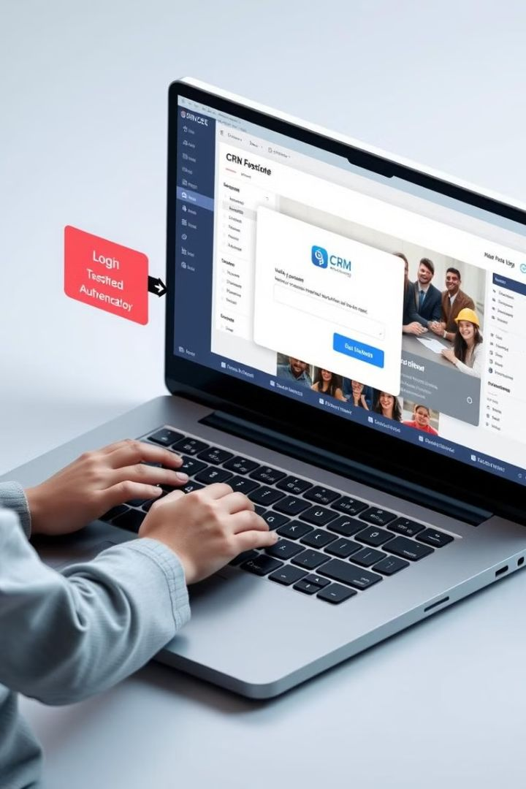
Workflow: Accessing Admin Functionalities
1
Login Page Access
2
Credential Input
Users start by accessing the CRM system through the login page, where they are prompted to enter their credentials.
The system requires valid credentials, including a unique username and a secure password, to ensure authorized access.
3
Successful Authentication
Upon successful authentication, the system redirects the user to the main Admin Dashboard, granting access to its management tools.
This streamlined process ensures that only authorized personnel can access and manage the CRM system, maintaining data integrity and system security. It's a critical first step in leveraging the dashboard's functionalities for enhanced project management.

Slide 63
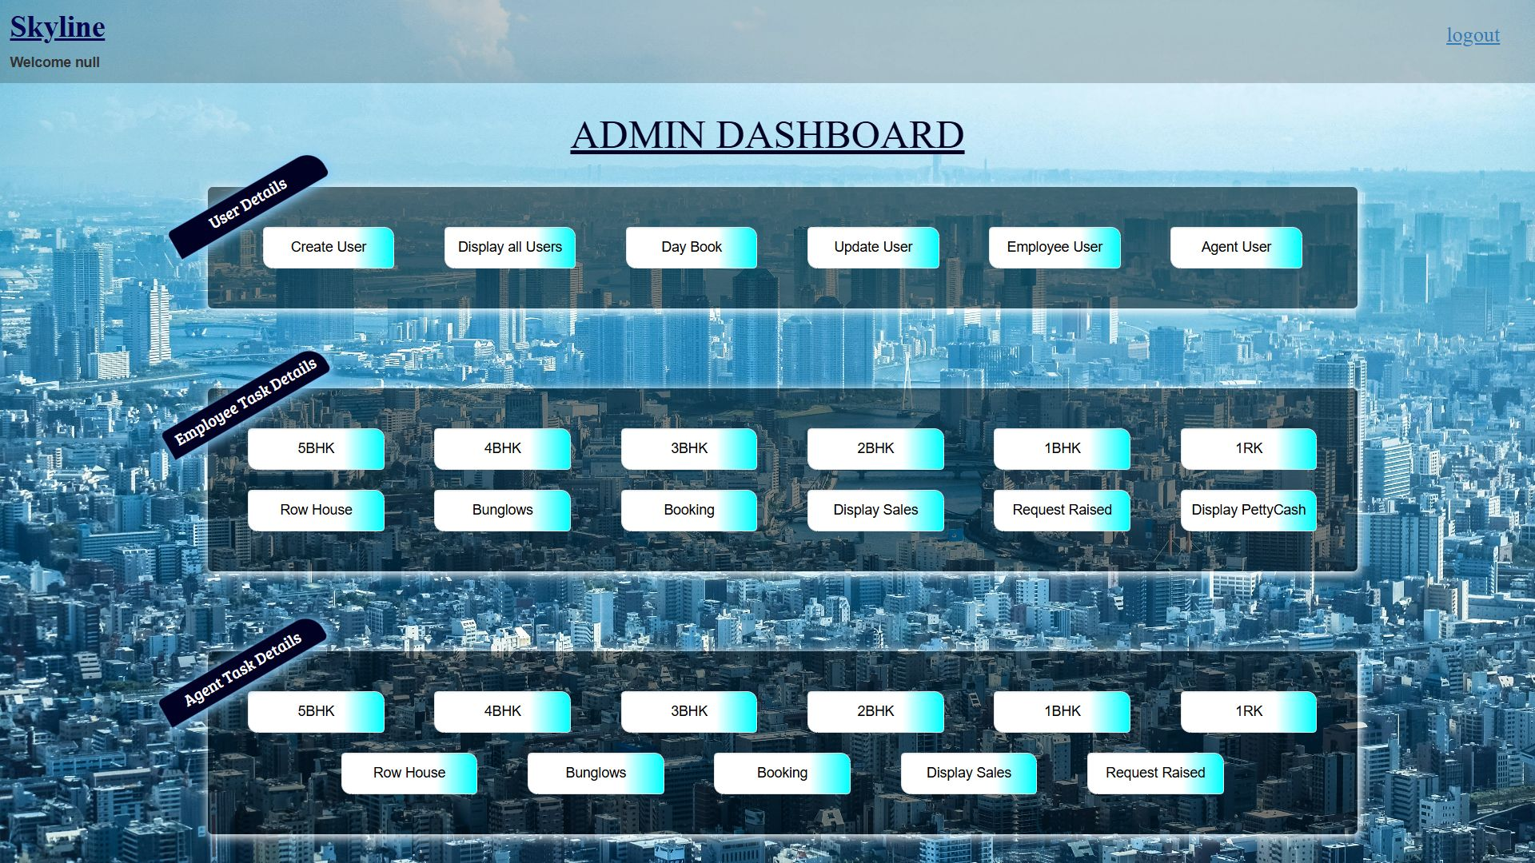

Slide 64
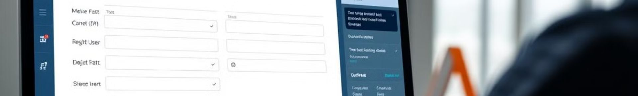
Create User Registration
Access Form
1
Navigate to the "Create User" option located in the "User Details" section of the Admin Dashboard.
2
Complete Details
Fill out all the required fields in the New User Registration form, including personal details, account credentials, and user type.
Submit or Reset
3
After completing the form, click "Submit" to register the user or "Reset" to clear the form and start over.
This process allows administrators to quickly and accurately add new users to the CRM system. By capturing comprehensive user information during registration, the system ensures data integrity and streamlined management. The "Reset" option provides an efficient way to correct errors and ensure accurate user data entry.

Slide 65
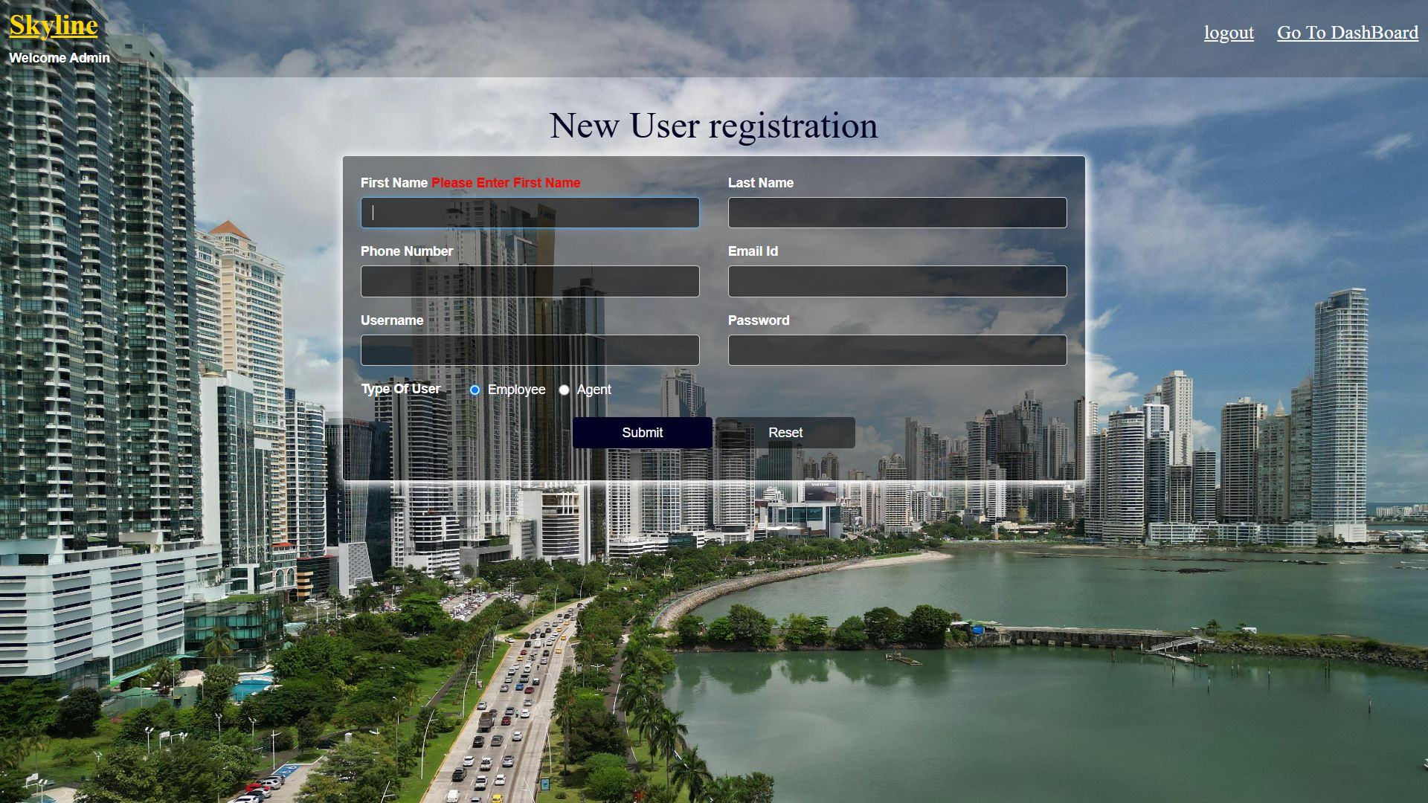

Slide 66
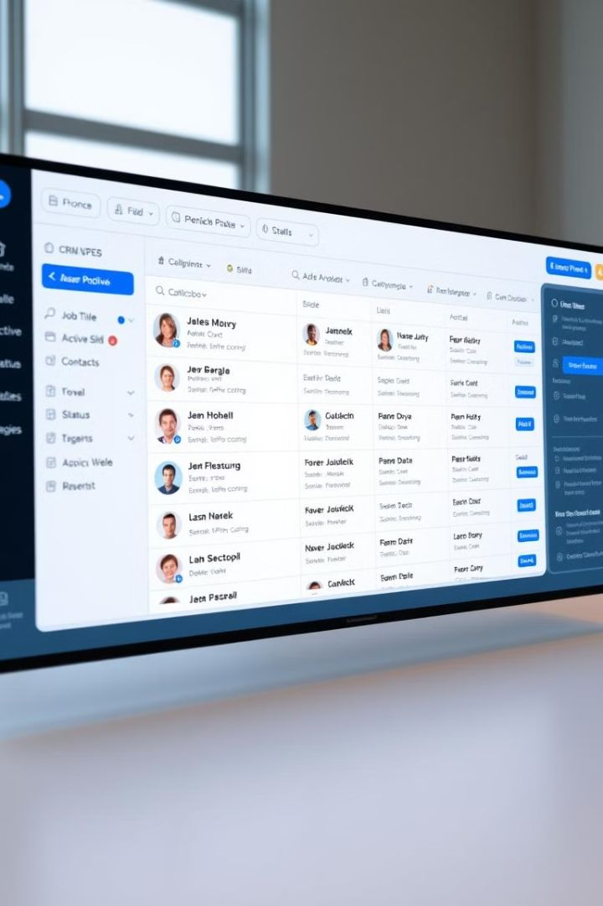
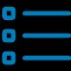


Display All Users
Comprehensive List
User Details
Easy Navigation
Access essential user information, including name, role, status, and contact details.
Quickly locate and manage users through an intuitive interface.
View a detailed list of all registered users within the CRM system.
The "Display All Users" feature provides a centralized view of all registered users, enabling administrators to efficiently manage user accounts. With easy access to crucial details, administrators can quickly monitor and maintain user information, ensuring data accuracy and compliance within the CRM system. This functionality enhances overall user management and system oversight.

Slide 67
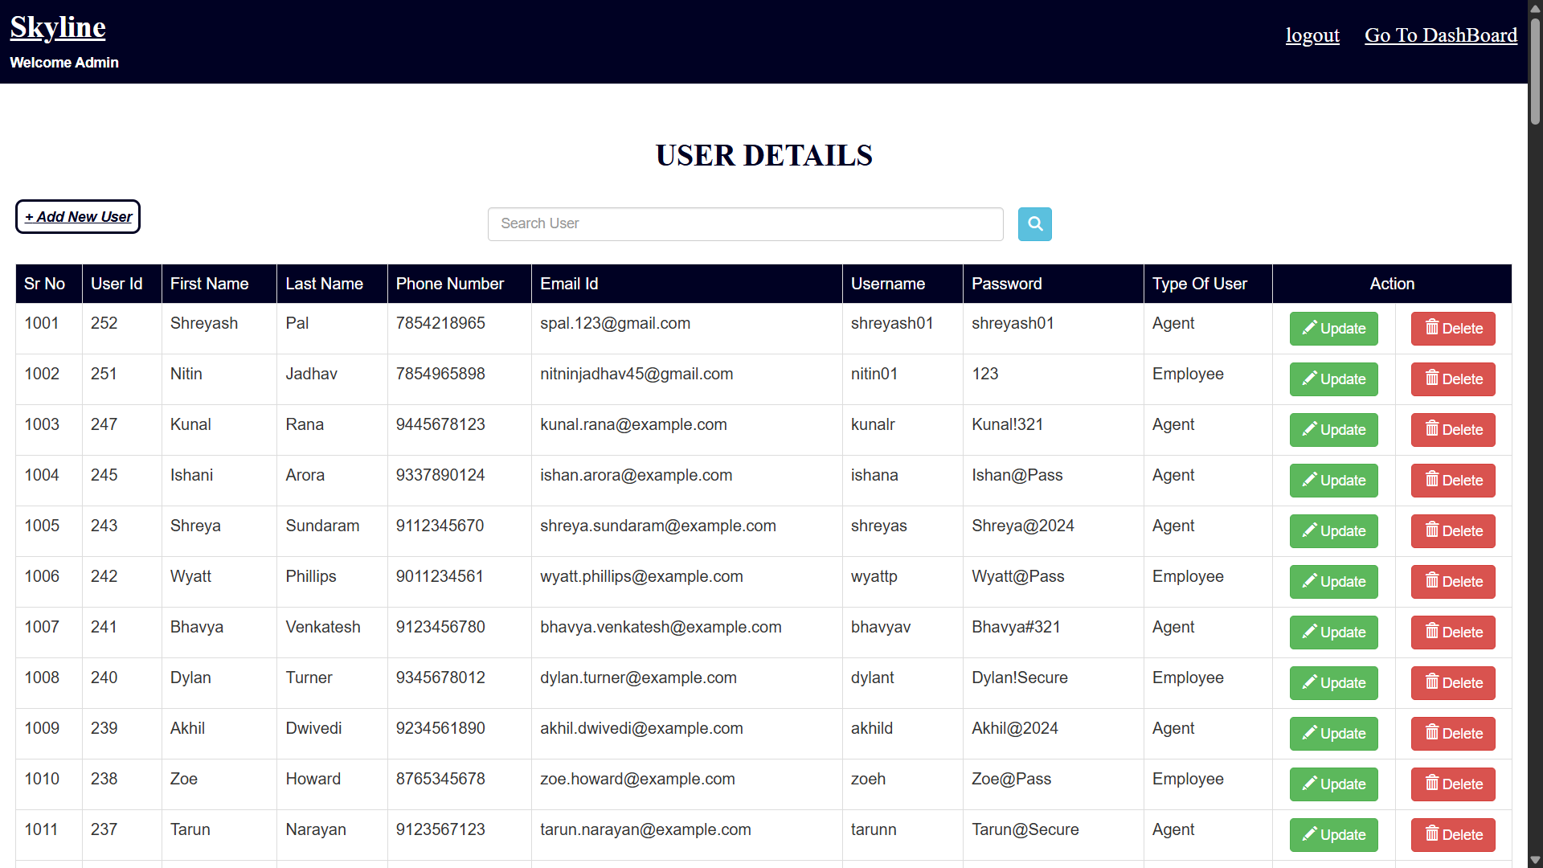

Slide 68
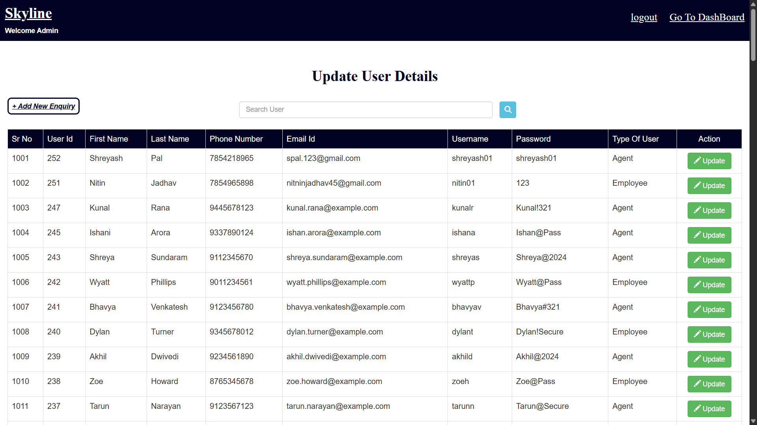

Slide 69
Update User Details
Select User
Access Update
Modify Fields
Save Changes
Choose a specific user from the displayed list to modify their details.
Click on the "Update User" button to enter the modification interface.
Update necessary fields such as contact information or user role.
Save all changes to immediately update the user's profile in the system.
This update feature allows administrators to maintain current and accurate user information, ensuring the CRM system reflects the latest changes within the organization. By providing a straightforward method to modify user profiles, the system enhances operational efficiency and reduces administrative overhead.

Slide 70


Slide 71


Slide 72

Accessing the Day Book
Financial Records
The Day Book provides access to financial data. This includes payments and expenses. It also covers income records.
Payments Received
Expenses
Income

Slide 73




Financial Metrics in Day Book
Payment Received
Displays total revenue collected. Provides insights into income trends.
Expenses
Tracks all outgoing transactions. Helps monitor financial outflow.
Income
Breaks down net earnings. Supports revenue analysis.

Slide 74



Understanding Payments Received
2
Payment Methods
Cash, credit card, electronic transfers. Diverse payment options.
Total Revenue
Collected from sales and services. Reflects business performance.
1
Payment Trends
Daily, weekly, monthly analysis. Helps predict future earnings.
3

Slide 75



Analyzing Net Income
Gross Income
1
Total revenue before deductions.
Operating Expenses
2
Costs for running the business.
Net Income
3
Profit after all deductions.

Slide 76


Slide 77








Employee User Management
View Employees
Manage Details
Monitor Progress
Assign Tasks
The Employee User section provides specific tools for managing users categorized as employees within the CRM system. This feature enhances the focus on employee-related tasks and information. Administrators can easily access, modify, and oversee employee accounts, ensuring that all details are accurate and up-to-date. Efficient employee task management is crucial for overall productivity.

Slide 78


Slide 79
Agent User Management
Access Agents
1
Quickly access and manage users classified as agents.
Task Assignment
2
Efficiently assign tasks to agents for streamlined operations.
Monitor Progress
3
Track task progress to ensure deadlines are met.
The Agent User section is designed specifically for managing agents within the CRM system. This includes tools for task assignment, performance tracking, and communication logs, tailored to agent-specific functionalities. By providing a dedicated interface, the system ensures efficient oversight of agent activities and improves overall productivity within the construction company.

Slide 80


Slide 81

Employee Task Details: 5BHK Properties
Navigate to Section
Access the Employee Task Details area.
Select Property Type
Choose 5BHK from the property categories.
Assign/View Tasks
Manage tasks specific to 5BHK properties.
The CRM simplifies task oversight for various property types. Focus on 5BHK units for streamlined project handling.

Slide 82


Slide 83

Task Management for 4BHK Properties
1
Go to Employee Task Details
2
Choose 4BHK
Select the 4BHK property type.
Find the task management section.
3
Handle Task
Assign, review, or update tasks.
Efficiently manage construction tasks for 4BHK property types with ease. Ensure projects stay on track.

Slide 84


Slide 85


Managing Tasks: 3BHK Properties
Navigate
Select
Manage
The CRM offers effective task oversight. It simplifies project handling for 3BHK units. Stay organized throughout the construction process.

Slide 86


Slide 87
Task Handling: 2BHK Properties
Employee Task Details
2BHK Category
Easy navigation
Specific tasks
Clear layout
Detailed views
The CRM facilitates the assignment and monitoring of tasks. It’s tailored for 2BHK properties. Utilize focused, streamlined management.

Slide 88


Slide 89








Task Control: 1BHK Properties
Navigate
Select 1BHK
View Tasks
Assign
Effectively control tasks within the CRM. Use it for 1BHK projects. Ensure timely completion and quality.

Slide 90


Slide 91

Task Management: 1RK Units
Employee Task Details
Property Categories
Task Assignment
Streamline task management for 1RK units with precision. Enhance project tracking and efficiency.

Slide 92


Slide 93
Task Oversight: Row-House Projects
1
Task View
2
Row-House
3
Assignment
Enhance task oversight for row-house construction. Use targeted task assignments and monitoring. Boost project outcomes.

Slide 94


Slide 95

Task Handling: Bungalow Construction
1
2
Navigation
Selection
3
Management
Effectively handle tasks for bungalow projects via the CRM. Stay organized for successful project delivery.

Slide 96


Slide 97
Booking Management
Booking Details
Benefits
The "Booking" section allows to view and manage bookings. The bookings are made by employees for different properties.
Centralized booking data
Improved coordination
Better resource allocation
This feature ensures all booking data is centralized. Quick access to booking details improves coordination and resource allocation.

Slide 98


Slide 99

Track Property Sales
Display Sales
Employee Sales
Simply click on the "Display Sales" button to view detailed reports.
The system provides sales data linked to specific employees.
Performance insights
This feature enhances transparency and aids performance management.

Slide 100
Sales Data Entry
1
Input Sales Data
2
Correlate to Activities
3
Update Records
The "Sales Entry" section enables the input of sales data linked to agent activities. Submit this data to update sales records for accurate tracking.

Slide 101


Slide 102


Streamline Request Management
Raise Requests
Employees can easily submit property-related requests.
Review
Requests are forwarded for prompt review and action.
Action
Necessary actions are taken promptly.

Slide 103


Slide 104
Manage Petty Cash Expenses
Display PettyCash
Property Transactions
Business Operations
Click "Display PettyCash" to review expenses.
Track cash flow related to transactions.
Monitor expenses for operational activities.

Slide 105


Slide 106


Agent Activity & Property Management
Agent Details
Property Types
Task Management
Manage agent-related tasks and performance by selecting a property type. Property types include 5BHK, 4BHK, 3BHK, 2BHK, 1BHK, and more.

Slide 108


Optimize Sales Performance
Agent Sales
Property Links
Performance Data
Click "Display Sales" to see sales performance of your team. Analyze agents and their properties. Data helps identify top performers and areas for improvement.

Slide 109

Sales Overview Display
1
Property Categories
Sales are categorized by property type.
2
Quantity Sold
The quantity sold is displayed for each property.
3
Detailed Overview
Review comprehensive sales performance.
View a sales overview, which is categorized by property type and quantity sold, providing insights.

Slide 110


Slide 111

Efficient Agent Requests
1
Request Submission
2
Approval Processes
Agents can raise requests for client concerns.
Requests include commission and transaction updates.
3
Admin Review
The admin reviews and addresses requests promptly.

Slide 112


Slide 113

Conclusion
Efficient Management
Organized CRM System
The Admin Dashboard ensures streamlined management of users. This also includes streamlined management of employee tasks.
Each function maintains a robust and organized CRM system. This promotes productivity.
Informed Decision-Making
The functions facilitate informed decision-making. This will enhance strategic planning.
The Admin Dashboard is designed for efficient management. It ensures users, employee tasks, and agent activities are streamlined. The functions foster productivity and informed decision-making.

Slide 114

CRM Project Conclusion: Streamlining Customer Relationships
This presentation summarizes the CRM project, its objectives, and achieved goals. The primary aim was to enhance customer relationship management and boost sales. The project has now successfully transitioned to ongoing operations, marking a new chapter in efficiency.

Slide 115
Key Features & Benefits of Our CRM System
User Management
Advanced Financial Tracking
Efficient user creation and updates
Booking and payment management
Role-based access control
Sales entry and commission calculations
Property Task Allocation
Request Management System
Categorized property types
Streamlined internal communication
Easy task assignment
Approval workflow

Slide 116

Project Outcome: Enhanced Efficiency & Communication
Efficiency
Communication
Management
Streamlined operations from registration to task allocation.
Improved communication among employees, agents, and admins.
Well-structured approach to handling real estate transactions.

